Slide 1
CoAP – Constrained Application Protocol
Raghuram Sudhaakar
Xavi Vilajosana

Slide 2
Background
ReST – Representational State Transfer
Identification of resources
Manipulation of resources through these representations
Self-descriptive messages
Basis for HTTP – the ubiquitous web protocol
Notes:
Individual resources are identified in requests, for example using URIs in REST systems. The resources themselves are conceptually separate from the representations that are returned to the client.
When a client holds a representation of a resource, including any metadata attached, it has enough information to modify or delete the resource on the server, provided it has permission to do so.

Slide 3
CoAP Basics
Constrained web protocol fulfilling M2M requirements.
UDP transport binding with optional reliability.
Asynchronous, Stateless message exchanges.
Low header overhead and parsing complexity.
URI and Content-type support.
Resource Observation
Application
Request/Response
CoAP
Messaging
UDP

Slide 4
CoAP Messaging
Request-Response Model
Supports Reliable message delivery
Node A
Node B
CON [0xbc90] GET /temperature (Token 0x71)
Msg Types | CON | NON | ACK | RST
Request | X | X | - | -
Response | X | X | X | -
Empty | * | - | X | X
ACK [0xbc90]
2.05 Content
(Token 0x71)
"22.5 C"

Slide 5
CoAP Methods
Four basic methods
GET, POST, PUT, DELETE
Responses categorized into 3 classes
2xx - Success: The request was successfully received, understood, and accepted
4xx - Client Error: The request contains bad syntax or cannot be fulfilled
5xx - Server Error: The server failed to fulfill an apparently valid request

Slide 6
Options and URIs
Options
Used to describe identify resources and how a request should be processed
Example options – Accept, Content-Format, Uri-Path, Uri-Query
Conditional options - If-Match, If-None-Match
URI Scheme
coap://host [:port] [/path] [ "?" query ]
Example – Options -> URI
Destination IP Address = [2001:db8::2:1]
Destination UDP Port = 5683
Uri-Host = "example.net"
Uri-Path = ".well-known”
Uri-Path = "core”
URI scheme and Options can be used in conjunction to optimize total payload size
coap://example.net/.well-known/core
Notes:
Option are of 2 types – Critical and Elective
Accpet – described what representations are supported
Content-Format – type of payload
4) Section 6.4 and 6.5 of draft-ietf-core-coap-18 describe URI to Options and Options to URI translations
5) CoAP does not impose message size restrictions, but considering the use in sensor n/w it is better to limit CoAP message sizes to less that the max PDU of L2

Slide 7
Other Topics
Security
Supports “coaps” using Datagram TLS (DTLS)[RFC6347]
DICE (DTLS for constrained environments) WG works on this
Discovery
Service discovery
Resource discovery – recommends using CoRE Link Format [RFC6690]
Proxying
HTTP ➔ CoAP and CoAP ➔ HTTP is well defined
Example usage : By root nodes in a RPL tree
Caching
CoAP defines which responses can be cached
Freshness of cache calculated using Max-Age option

Slide 8
Observing Resources in CoAP draft-ietf-core-observe-09

Slide 9
The Problem
REST Model -> Client exchange representation of objects with Server.
What if a client wants to have the current state of a resource over a period of time?
Polling? (too expensive)
Client
Server
State of resource X request
Representation of the resource at the time of request

Slide 10
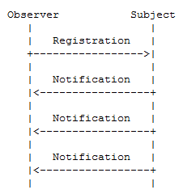
Observer pattern to scale
draft-ietf-core-observe-09:
"observe" a resource on a CoAP server: the client can retrieve a representation of the resource and keep this representation updated by the server over a period of time.
This is one of the most used Soft. Eng. Patterns: Observer Design Pattern.

Slide 11
Roles
Subject: subject is a resource whose state can change over time (e.g from infrequent updates to continuous state transformations.)
Observer: An observer is a CoAP client that is interested in having a current representation of the resource at any given time.
Registration: A client registers its interest in a resource by initiating an extended GET request to the server. The server returns the current state of the resource + adds the client (endpoint + token) to the list of observers of that resource.
Notification: Whenever the state of a resource changes, the server notifies each client in the list of observers of the resource. Each notification is an additional CoAP response sent by the server in reply to the GET request and includes a complete, updated representation of the new resource state.

Slide 12
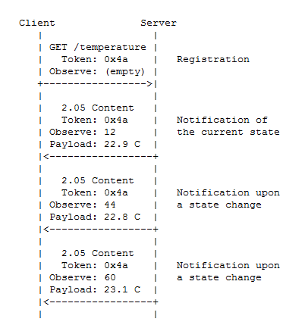
Example
*The Observe Option contains
a sequence number for ordering
purposes.

Slide 13
Observe Option
In a GET: extends the GET method so it does not only retrieve a current representation of the target resource, but also requests the server to add a new entry to the list of observers of the resource.
In a response, the Observe Option identifies the message as a notification. This implies that the server has added the client to the list of observers and that it will notify the client of changes to the resource state. It is a 24bit sequence number.

Slide 14
Other features
Freshness: Age > Max-Age Option and no newer notification/response has been received.
Aggregation: If a server can notify a client about the change of state of two different resources, this two notifications can be embedded in the same message.
Ordering: using 24bit strictly increasing num.
Reliability: Notifications can be CONFIRMABLE or NON-CONFIRMABLE. If a CONFIRMABLE notification is not ACK, the server eventually unsubscribes the client.

Slide 15
References –
https://datatracker.ietf.org/doc/draft-ietf-core-coap/?include_text=1
http://tools.ietf.org/html/draft-ietf-core-coap-18
http://en.wikipedia.org/wiki/Representational_state_transfer
http://www.ietf.org/rfc/rfc3986
http://tools.ietf.org/html/draft-ietf-core-observe-09
http://datatracker.ietf.org/doc/draft-greevenbosch-dice-authent-author-revoc/

