Slide 1
ALTO Code Bases and Deployment
Luis Contreras, Ziyang Xing, Jensen Zhang, Kai Gao, Richard Yang, Jordi Ros-Giralt
IETF Plenary 114
ALTO WG Session
07/19/2022

Slide 2
Content
OpenALTO Code Base Architecture
OpenALTO Project Management and Approach
ALTO Deployments:
ALTO to Optimize Global Science Traffic at CERN
ALTO to Optimize MPTCP and MPQUIC Path Selection with SDN
ALTO Telefonica Deployment
IETF Hackathon 114: ALTO Project

Slide 3
OpenALTO Code Base Architecture

Slide 4
IETF ALTO Working Group
IETF ALTO Charter:
Standardizing a network API that applications can query to get the state of the network and to use this information to optimize their performance.
IETF ALTO history of applications / use cases:
Peer-to-peer applications → CDNs → {Cloud, Edge-computing, 5G, V2X, XR}
Participation from a variety of carriers, vendors and universities:
Nokia, Ericsson, Verizon, Comcast, Telefonica, Deutsche Telekom, Huawei, China Telecom, Google, Cisco, Samsung, Qualcomm, Yale University, Tsinghua University, etc.

Slide 5
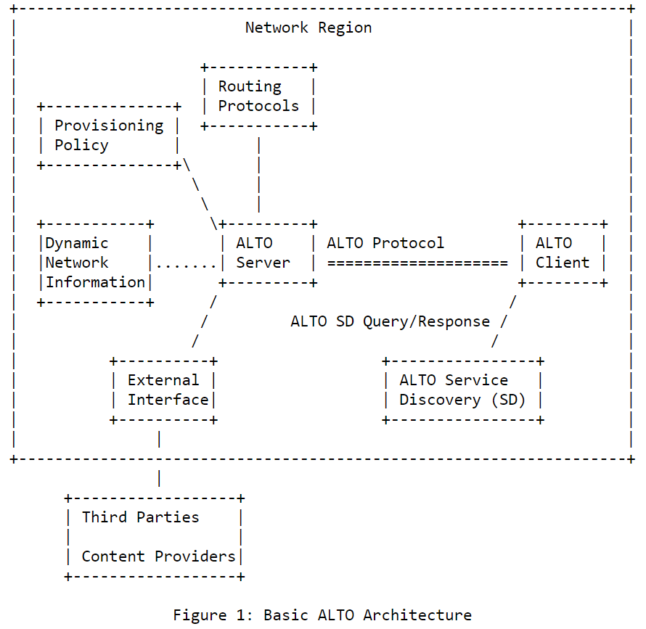
IETF OpenALTO Code Base Architecture
https://www.rfc-editor.org/rfc/rfc7285.txt

Slide 6
IETF OpenALTO Code Base Architecture
https://www.rfc-editor.org/rfc/rfc7285.txt
IETF ALTO stack
ALTO Services
Network map
Cost map
Property map
(…)
Southbound API

Slide 7
IETF OpenALTO Code Base Architecture
https://www.rfc-editor.org/rfc/rfc7285.txt
XR
V2X
IoT
Science
CDN
(…)
IETF ALTO stack
Northbound API
ALTO Services
Network map
Cost map
Property map
(…)
Southbound API

Slide 8
IETF OpenALTO Code Base Architecture
https://www.rfc-editor.org/rfc/rfc7285.txt
XR
V2X
IoT
Science
CDN
(…)
IETF ALTO stack
Northbound API
ALTO Services
Network map
Cost map
Property map
(…)
Southbound API
SDN Controller
DCN
WAN
Backhaul Midhaul Fronthaul
RAN
Mobile Core
(…)

Slide 9
OpenALTO Project Management and Approach

Slide 10
Project Management and Approach
The ALTO Code Base Project provides a parallel track to the WG’s standardization effort towards implementing the features introduced in the latest RFCs.
IETF Hackathons will be used as 3-checkpoints a year to test interoperability, demo latest standard capabilities and identify issues and improvements for standardization.
Identify and build production, open-source environments for use cases and deployment ("lean startup") to help steer ALTO standardization.
TEAM
EPIC
SCRUM
CODING
JAN
FEB
MAR
Hackathon
APR
MAY
JUN
JUL
Hackathon
AUG
SEP
OCT
NOV
Hackathon
DEC

Slide 11
Project Management and Approach
Adopting industry standard Agile / Scrum methodologies to ensure:
Productivity
Quality
Participation
Lean startup, rough consensus running code
Invoke community participation to develop the ALTO Code Base:
Two roles: developers and mentors.
Mentors are usually experienced members of the IETF ALTO WG
Developers usually come from universities and the industry in general
Project management resources:
Repo: https://github.com/openalto/
Project Scrum Dashboard (IETF Hackathon 113): https://github.com/orgs/openalto/projects/1

Slide 12
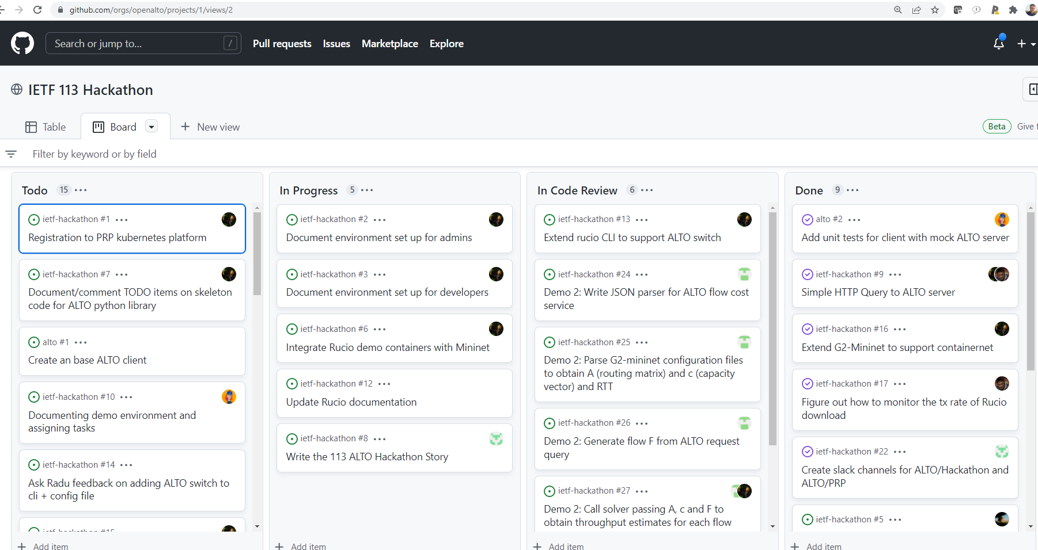
Project Management and Approach
Scrum dashboard:

Slide 13
ALTO Deployments

Slide 14
ALTO Deployments
Current implementations/deployments:
Wiki list of implementations: https://trac.ietf.org/trac/alto/wiki/Impl
Examples:
Comcast P4P: RFC 5632: https://datatracker.ietf.org/doc/html/rfc5632
Benocs: https://people.csail.mit.edu/gsmaragd/publications/CoNEXT2019/CoNEXT2019.pdf
Telefonica: https://dl.ifip.org/db/conf/im/im2021mini/212012.pdf
Forthcoming new deployments (work in progress):
Pacific Research Platform
CERN FTS / Rucio
UCSD 5G
MPQUIC, MPTCP
Edge Cloud
Science Networks

Slide 15
ALTO to Optimize Global Science Traffic at CERN

Slide 16
XXX WIP

Slide 17
ALTO Telefonica Deployment

Slide 18
XXX WIP

Slide 19
ALTO to Optimize MPTCP and MPQUIC Path Selection with SDN

Slide 20
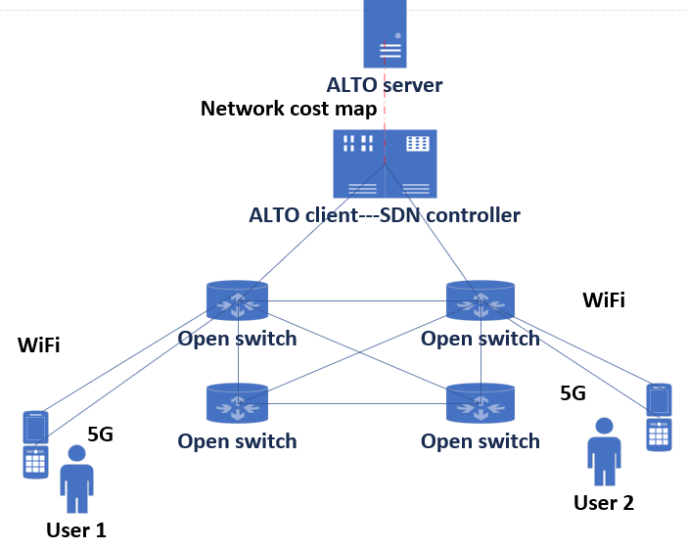
Deployment of ALTO in Multipath transmission
Architecture
ALTO Server: collect network status information
ALTO Client: controller in SDN
Collect network performance data from the network every 2 hours
Controller allocates MPTCP or MPQUIC packets to suitable transmission paths according to the network cost indicators by ALTO
Test environment
1.SDN controller: OpenDaylight
2.Network topo: Mininet
3.SDN server and client: MPQUIC-go \ MPTCP
4. Traffic measurement: mahimahi \ Wireshark

Slide 21
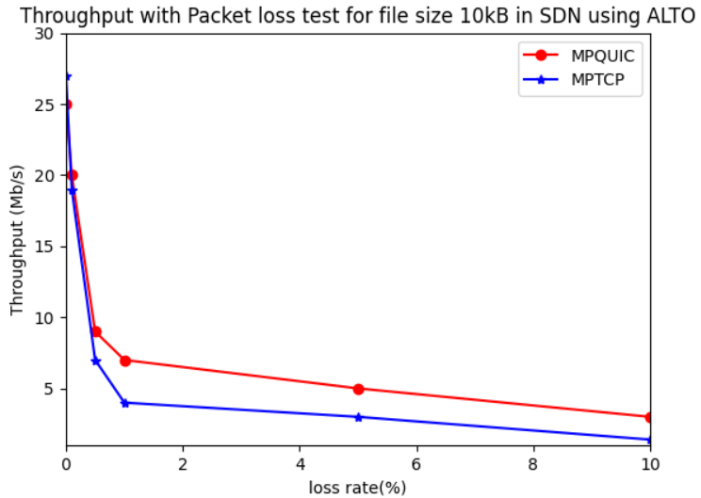
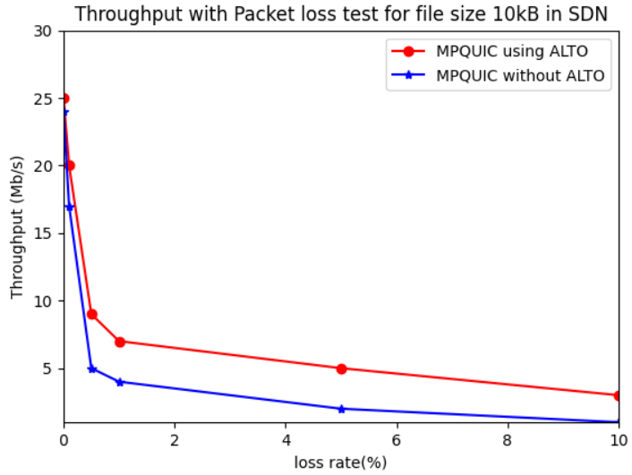
Test result
The throughout of MPQUIC/MPTCP using ALTO is higher than without ALTO in SDN especially in poor network

Slide 22
IETF Hackathon 114: ALTO Project

Slide 23
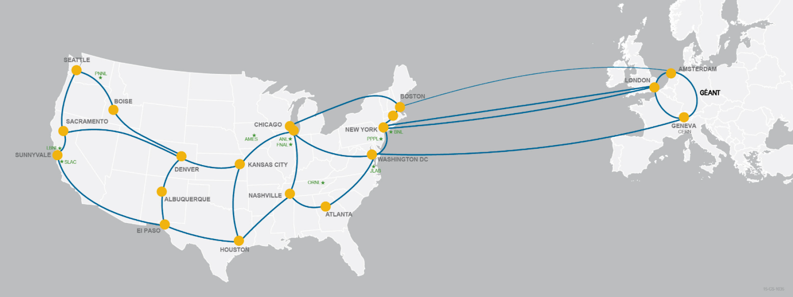
Goal of the Hackathon Project
Use ALTO path vector to help achieve resource control in FTS, the file transfer service used in scientific projects such as ATLAS, CMS, and LHC
Continuation of IETF Hackathon 113
In IETF 113, ALTO support is added to Rucio, the data management system of CERN
CERN / LHC
* ESnet / LHCONE source: https://www.es.net/about/

Slide 24
RFCs Involved in the Hackathon
RFC-to-be: An ALTO Extension: Path Vector
https://datatracker.ietf.org/doc/draft-ietf-alto-path-vector/
RFC 9240: An Extension for Application-Layer Traffic Optimization (ALTO): Entity Property Maps
https://datatracker.ietf.org/doc/rfc9240/
I-Draft ALTO Extension: Flow-based Cost Query
https://datatracker.ietf.org/doc/draft-gao-alto-fcs/

Slide 25
What Got Done
Application side:
[TBD] ALTO-enabled optimizer integrated in FTS
[TBD] Pull request to FTS
[TBD] Demo: ALTO-enabled FTS optimizer achieves resource control and improves aggregated throughput
Server side:
Path vector service is added to the OpenALTO project, providing bandwidth and latency information
Mininet/OpenDaylight plugin
[TBD] Pull request to OpenALTO
Infrastructure:
Customizable containerized environment for Rucio/FTS

Slide 26
XXX WIP

Slide 27
Discussion Q&A
Thank you

Slide 28
References
[1] SDN controller OpenDaylight https://github.com/opendaylight/controller
[2] Network topo https://github.com/mininet/mininet http://mininet.org/
[3] MPQUIC source https://github.com/lucas-clemente/quic-go
[4] traffic measurement http://mahimahi.mit.edu/
[5] ALTO project https://github.com/cutecollege/sextant
[6] Coninck Q D , Bonaventure O . MultipathTester: Comparing MPTCP and MPQUIC in Mobile Environments[C]// 2019 Network Traffic Measurement and Analysis Conference (TMA). 2019.
[7] V. K. Gurbani, M. Scharf, T. V. Lakshman, V. Hilt and E. Marocco, "Abstracting network state in Software Defined Networks (SDN) for rendezvous services," 2012 IEEE International Conference on Communications (ICC), 2012, pp. 6627-6632.
[8] Faigl, Z. , Z. Szabo , and R. Schulcz . "Application-layer traffic optimization in software-defined mobile networks: A proof-of-concept implementation." IEEE(2014):1-6.
[9] 7. K. Gao, C. Xu, J. Qin, S. Yang, L. Zhong and G. Muntean, "QoS-driven Path Selection for MPTCP: A Scalable SDN-assisted Approach," 2019 IEEE Wireless Communications and Networking Conference (WCNC), 2019, pp. 1-6

