Slide 1
IETF Sponsorship
An overview of the sponsorship opportunities for IETF meetings

Slide 2
Support the IETF

Slide 3
Support the Community. Sponsor an IETF Meeting!
The Internet Engineering Task Force (IETF) is the world’s premier Internet standards setting organization. It operates as a large, open, international community of network designers, operators, vendor experts, researchers, and other interested technologists.
The work of the IETF promotes the evolution, advancement, and smooth operation of the Internet through the development and refinement of Internet technical standards.
Face-to-face meetings take place 3 times per year. 1,200+ individuals attend each IETF meeting and come from more than 40 countries.

Slide 4
Why Sponsor?
The IETF gives sponsors an opportunity to positively promote themselves in front of 1200+ individuals seen as thought leaders in the industry and representing high profile organizations from across the globe.
Giving constant networking opportunities throughout the week with individuals at a senior level, IETF meetings provide unique opportunities for sponsors to access the people influencing the way people design, use and manage the Internet.
Beyond informal networking, sponsors of IETF events are associated through their support with the collaboration among top technical thinkers that has been and is the hallmark of Internet innovation.

Slide 5
Sponsorship Opportunities
Meeting Host (1, but co-hosting can be discussed)
Meeting Connectivity Sponsor
Welcome Reception
Hospitality Suite*
Refreshment (Bottled water with logo)*
Breakfast*
Bits-N-Bites
Ice Cream Social
Beverage / Snack Breaks
* dependent on location, please enquire

Slide 6
Meeting Host - Benefits
Logos on meeting website and signage (provided by the IETF, Host can provide additional signage i.e. banners)
Logos on t-shirts and lanyards (provided by Host)
Organizational Membership to Internet Society (or upgrade for current members)
Public acknowledgement by the IETF at the Plenary
10 complimentary registrations for the meeting
5 complimentary registrations for an earlier meeting (for Host personnel to aid in preparation)
Bits-N-Bites exhibition space
Choose speaker and topic for Thursday Lunch Speaker Series
Social media promotion

Slide 7
Hosting - Costs
The cost of hosting an IETF Meeting varies based on the location, an approximate amount is $333,000 (USD)
Meeting space costs vary on venue location
T-shirts and lanyards provided by Host (approx. $10,000)
Tuesday Social
This is optional and costs are entirely dependent on host’s choice of venue (the IETF is not usually aware of these costs)
A ticket price of $25 - $40, less fees, is returned to Host (around 500 – 700 tickets will be required)

Slide 8
Meeting Connectivity
Sponsor contributes two 1G/10G circuits with full IPv4 and IPv6 routes delivered to the venue.
Logo on meeting website
5 complimentary registrations
Logo and recognition in the IETF Journal
Acknowledgement at the Plenary and in the Proceedings of the meeting
Organizational membership in the Internet Society (upgrade for current members)
Table for literature and pop-up banner

Slide 9
Welcome Reception - $50,000 (USD)
IETF provided signage, sponsor literature / visual display area
Logo on IETF Journal, meeting website, Internet Society website and social media promotion
5 Complimentary registrations
Speaking opportunity at reception
Public acknowledgement by the IETF at the Plenary
Press release

Slide 10
Hospitality Suite - $25,000 (USD)*
Meeting Program listing
IETF provided signage, sponsor literature / visual display area
Logo on IETF Journal, meeting website and social media promotion
Promotion on official IETF Meeting Attendee mailing list
* dependent on location, please enquire

Slide 11
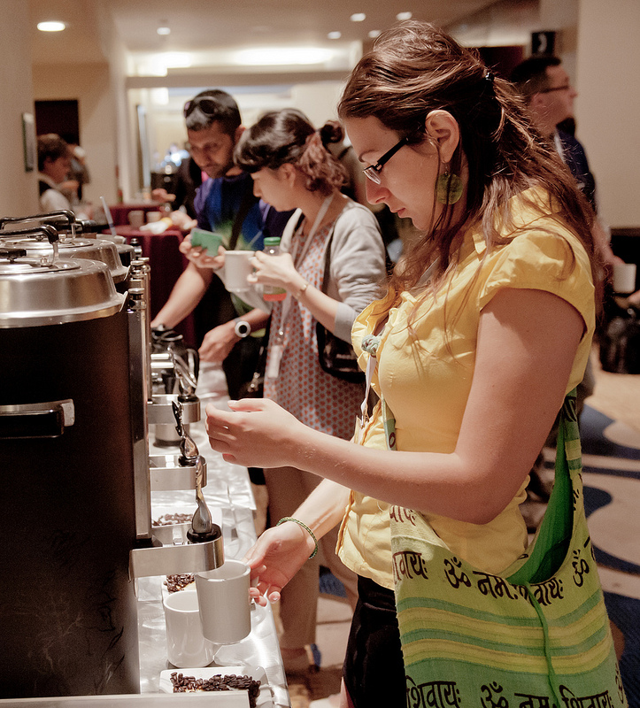
Breakfast - $15,000 (USD)*
5 available, 20% discount if sponsoring all
Meeting Program listing
IETF provided signage, sponsor literature / visual display area
Promotion on official IETF Meeting Attendee mailing list
Logo on meeting website and social media promotion
Logo on IETF Journal (if sponsoring at least 2)
* dependent on location, please enquire
Refreshment (Bottled water) - $25,000 (USD)*
Logo on all bottled water distributed to attendees throughout week (4,000+ bottles)
IETF provided signage
Logo on meeting website and social media promotion

Slide 12
Bits-N-Bites
Bits-N-Bites is an opportunity for exhibitors, product vendors, and service providers to share information and showcase products and services to the IETF community in a social setting.
The event takes place on Thursday evening for 700 people, with IETF provided food and beverages.
Each exhibitor table will include:
Electricity
Access to the IETF wireless network.
A table (minimum 6’) or space for alternate display for companies that have their own exhibition display / booth.
Any extra costs related to power or Internet will be borne by the sponsor.

Slide 13
Bits-N-Bites - $10,000 (USD)
Sponsor literature / visual display area
Meeting Program listing
IETF provided signage and sponsor provided signage if space allows
Logo on meeting website and social media promotion
2 Complimentary registrations

Slide 14
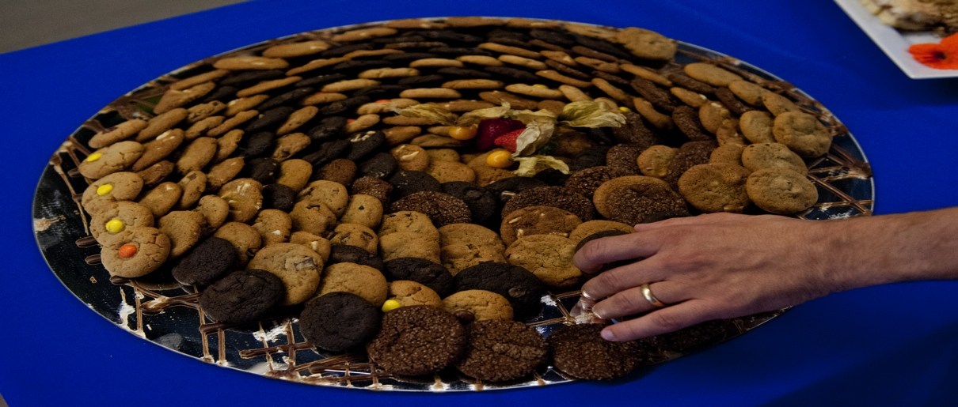
Ice Cream Social - $7,500 (USD)
Meeting Program listing
IETF provided signage
Promotion on official IETF Meeting Attendee mailing list
Social media promotion
1 Complimentary registration
Beverage / Snack Break - $6,000 (USD)
20% discount if sponsoring all
Meeting Program listing
IETF provided signage
Logo on meeting website (if sponsoring all 4) and social media promotion
Logo on IETF Journal (if sponsoring all 4)

Slide 15
IETF is the premier Internet standards setting organization
Be a part of it. Profile yourselves to this critical audience

Slide 16
Thank You!
For more information on how your company or organization can become involved with the IETF contact:
Drew Dvorshak - Director, Membership & Services
dvorshak@isoc.org
+1 703 439 2129
Emma Frost - Senior Manager, Organization Member Relations
frost@isoc.org
+1 571 299 2516

