Slide 1
Framework and Data Model for OTN Network Slicing
draft-zheng-ccamp-yang-otn-slicing-00
Co-authors:
Haomian Zheng (Huawei)
Italo Busi (Huawei) Aihua Guo (Futurewei)
Contributors:
Henry Yu (Huawei)

Slide 2
OTN Slicing Use Cases
OTN provides hard pipes with deterministic SLA.
OTN slicing is needed to support OTN-specific use cases like:
Leased Line Services with OTN
Co-construction and Sharing
Wholesale of optical resources
Vertical dedicated network with OTN

Slide 3
OTN Slicing Framework
An OTN slice is a collection of OTN network resources that is used to establish a logically dedicated OTN virtual network over one or more OTN networks
Some of the SLOs of an OTN slice are expressed in OTN-specific way. Generic SLOs follow the definition in
Bandwidth – number / type of ODU/OSU slots
Resources/labels – OTN tributary slots + tributary ports
Relationship with the IETF network slice YANG model (draft-liu-teas- transport-network-slice-yang-01) is for further investigation
Possible to augment the model defined by draft-liu-teas- transport-network-slice-yang-01

Slide 4
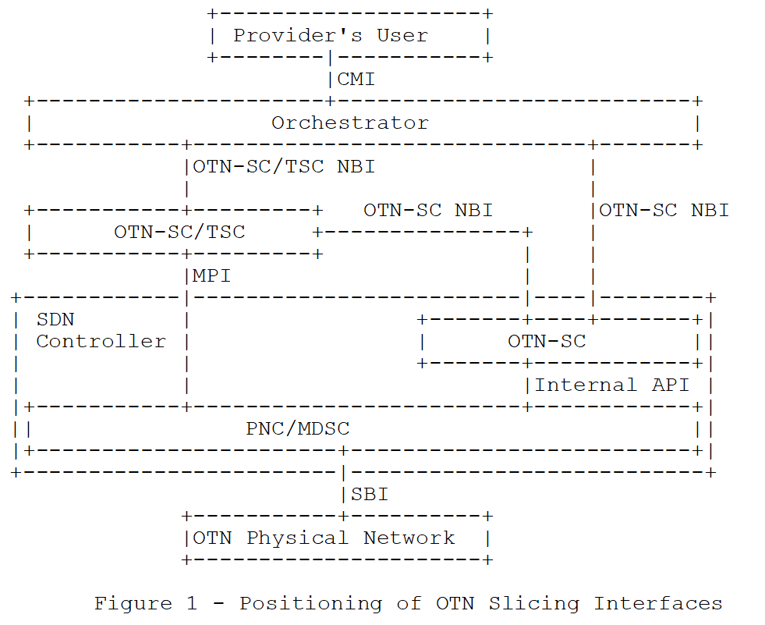
OTN Slicing Interfaces
OTN slice controller (OTN-SC) may be deployed either outside or within an SDN controller
Translating slice configuration into OTN TE topology or TE tunnel requests at the MPI, or
Interact with higher- or lower-level slice controller in a recursive manner
Interaction between OTN-SC and IETF network slice controller is for further study
An IETF network slice controller may use an OTN-SC to provision OTN slices to support end-to-end slicing

Slide 5
OTN Slicing Mode
Link-based slicing
A link is dedicated to a single OTN slice
Tributary slot-based slicing
Multiple OTN slices can share an OTN link but use different time slots

Slide 6
YANG models
TBD
Considering augmenting draft-liu-teas- transport-network-slice-yang-01

Slide 7
Next Step
YANG model definitions
Comments and co-authorship are welcome.
Thanks!

