Slide 1
A YANG Data Model for Microwave Radio Link draft-ietf-ccamp-mw-yang-01
J. Ahlberg (Ericsson)
M. YE (Huawei)
X. Li (NEC Laboratories Europe)
CJ. Bernardos (UC3M)
M. Vaupotic (Aviat)
K. Kawada (NEC Corporation)
D. Spreafico (Nokia - IT)
IETF 99 CCAMP July 2017 Prague

Slide 2
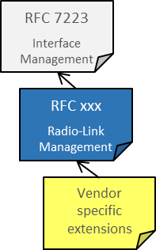
Overview
The draft defines a YANG data model in order to control and manage the radio link interfaces, and the connectivity to packet (typically Ethernet) interfaces in a microwave/millimeter wave node.
follows the framework in [draft-mwdt-ccamp-fmwk-01], which defines the use cases and requirements, and provides detailed gap analysis of the current existing/drafts models
augments RFC 7223 to align with the same structure for management of the packet interfaces.
uses established microwave equipment and radio standards, such as ETSI EN 302 217-2, and the [draft-ahlberg-ccamp-microwave-radio-link-01] and the ONF Microwave Models as the basis for the definition of the detailed configuration parameters and proposing new ones to cover the identified gaps that are analyzed in [draft-mwdt-ccamp-fmwk-01]
Interfaces Hierarchy
‘Ethernet Port’
‘TDM Port’
radio-link-terminal
carrier-termination
carrier-termination

Slide 3
Status
The draft was adopted by CCAMP WG, April 2016
Update from -00
Two new co-authors: Daniela Spreafico from Nokia, and Marko Vaupotic from Aviat
Model changes:
remove rx-frequency-config, and update the definitions of rx-frequency and duplex-distance to enable multiple configuration ways
add forced-switch as an identity for protection-external-commands
refine the model by better text description, or change the units in some leaves
Editorial changes:
add a clarification that the definition of the data nodes are based on established microwave equipment and radio standards, such as ETSI EN 302 217
to ensure a good alignment between the various standardization and modeling initiatives within the microwave domain and thereby address a concern raised in the review of the last version of the model
a new sub-section 3.2 to explain that some attribute in RFC7223 may not be relevant for this model.
Model validated in practice at IETF Hackathon
Two SDN applications implemented – Energy Efficiency & Dynamic Frequency Control

Slide 4
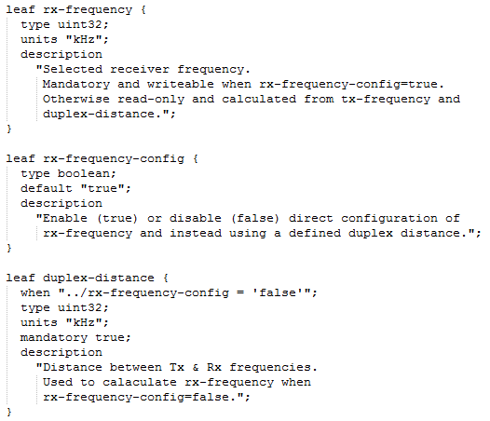
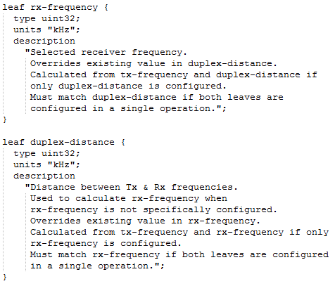
Model Changes CT – RX Frequency Config

Slide 5
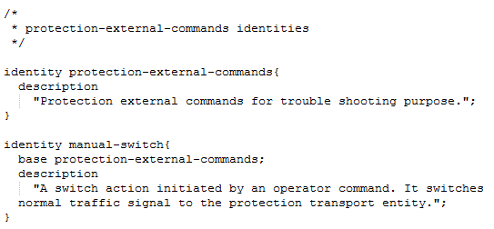
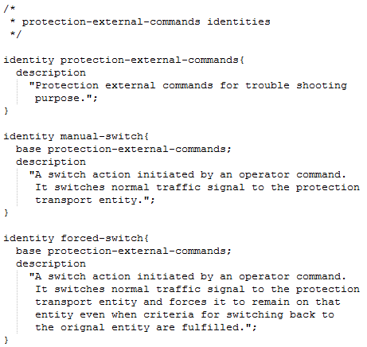
Model Changes Protection – External Commands

Slide 6
NEXT Steps
The model definition considered to be completed.
Your review and comments are welcome!
Asking for WG LC

