Slide 1
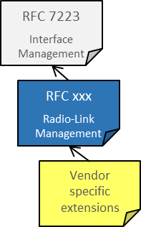
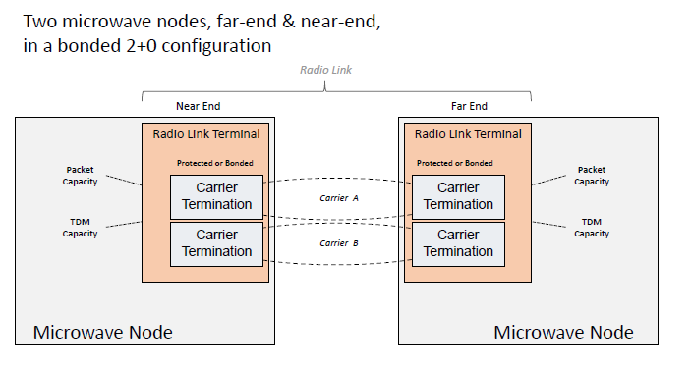
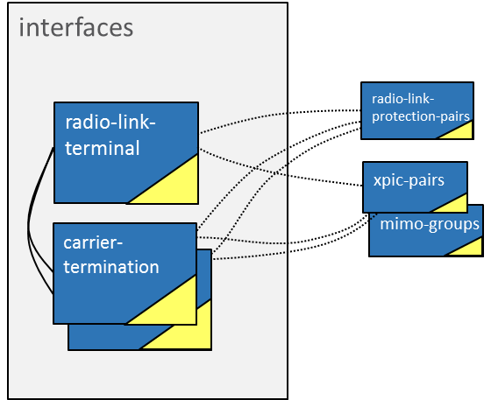
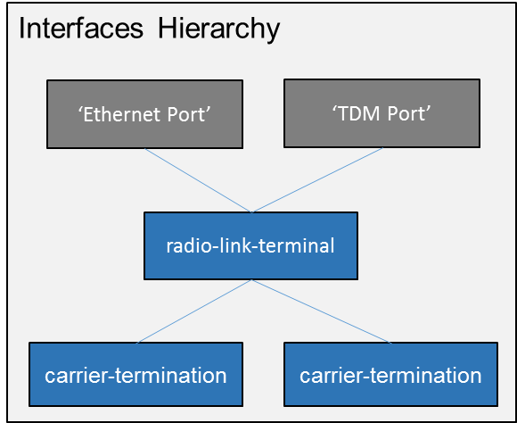
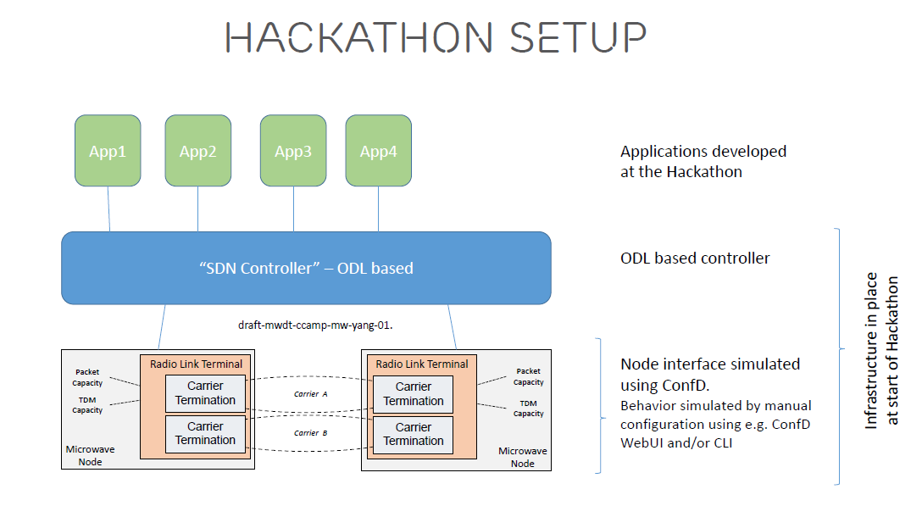
A YANG Data Model for Microwave Radio Link
INTRODUCTION
YANG DATA MODEL
RLT (Radio link termination)- config/state
CT (Carrier termination) - config/state
Protection - config/state
XPIC(Cross Polarization Interference Cancellation) – config
MIMO (Multiple-Input Multiple-Output)- config
Explain he goal of the data model
Terminology of RL, CT, etc.
Add some text about the setup (Jonas and Amy)
Use Case 1: Energy Efficiency
“What’s the target - purpose”
Initial status: complete configuration on 2+0 (move to setup)
Manually setting: in day time, set tx-enable of carrier B to TRUE; in the night set tx-enable of carrier B to FALSE
Time period may also be set: 8:00 – 24:00, tx-enable = TURE; 0:00 – 8:00, tx-enable = False
Use Case 2: Dynamic frequency control
Poll the SNIR/RSL/BER from the NE
The controller compares the value with a predefined threshold
if the value is small than threshold, the controller will
- Decide a new frequency for the link
- Disable the tx/rx
- Set the new tx-frequency/rx-frequency
- Enable the tx/rx

