Slide 1
sample-network-manager-device-mount
ietf-microwave-topology
container managed-devices {
list managed-device {
key managed-device-id;
leaf managed-device-id {
type nw:node-id;
}
yangmnt:mount-point "device-yang-root" {
}
}
}
ietf-bandwidth-availability-topology
ietf-network-topology
ietf-network
+--rw networks
+--rw network* [network-id]
+--rw network-id
+--rw network-types
+ rw mw-topology
+ rw link-bw-availability-topology
+--rw supporting-network*
| +--rw network-ref
+--rw node* [node-id]
| +--rw node-id
| +--rw supporting-node*
| | +--rw network-ref
| | +--rw node-ref
| +--rw termination-point* [tp-id]
| +--rw tp-id
| +--rw supporting-termination-point*
| | +--rw network-ref
| | +--rw node-ref
| | +--rw tp-ref
| +--rw microwave-tp
| +--rw rlt-interface-path
+--rw link* [link-id]
+--rw link-id
+--rw source
| +--rw source-node?
| +--rw source-tp?
+--rw destination
| +--rw dest-node?
| +--rw dest-tp?
+--rw supporting-link*
| +--rw network-ref
| +--rw link-ref
+--rw link-availability* [availability]
| +--rw availability
| +--rw link-bandwidth
+--rw microwave-link
1
One for each interface (RLT) or is there one list of interfaces per node or
Is the reference to a node?
ietf-microwave-radio-link (Radio Link Terminal)
ietf-Interface
+--rw interfaces
+--rw interface* [name]
+--rw name
+--rw description?
+--rw type = MicrowaveRadioLinkTerminal
…
+--ro speed?
+--ro statistics
…
+--rw id?
+--rw mode
+--rw carrier-terminations*
+--rw rlp-groups*
+--rw xpic-pairs*
+--rw mimo-groups*
+--rw tdm-connections*
+--rw tdm-type
+--rw tdm-connections

Slide 2
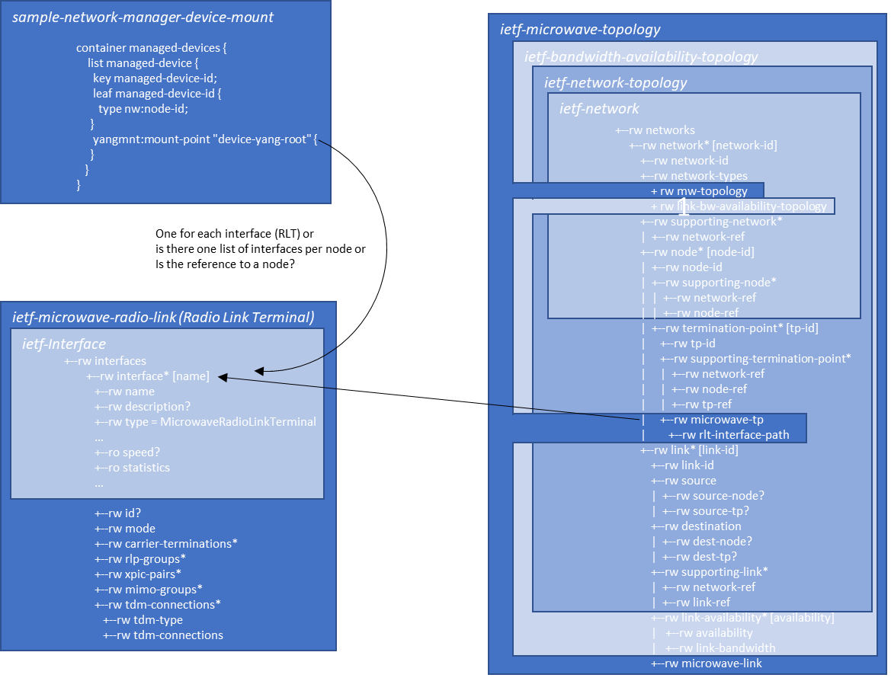
NBI
Controller
Mediation
SBI
MW
NE

