Slide 1
IETF 78
Cloud Logging
Gene Golovinsky
gene@alertlogic.com

Slide 2
The Traditional Logging
Practically all hw and sw entities log their activities
Network elements and Unix/Linux servers – Syslog
Windows servers – Windows event facility
Applications – proprietary files
Despite difference in format they all generally have enough information to identify
Actual entity
Type of activities
Time of occurrence
Often user identity

Slide 3
Applications of Traditional Logging
Variety of applicable problem spaces:
System management
Network Management
SIEM
Forensics
Auditing
Regulations and Compliance (PCI, SOX, HIPPA)
Applicability depends on the availability and accuracy of the data

Slide 4
Log Sample
Mar 7 23:21:06 itcore-fwsm-1-Ricks-1/itcore-fwsm-1-Ricks-1 %FWSM-4-106023: Deny udp src outside:152.1.20.9/4080 dst inside:152.7.128.4/1434 by access-group "outside_access_in" Mar 7 23:21:08 itcore-fwsm-1-Ricks-1/itcore-fwsm-1-Ricks-1 %FWSM-4-106023: Deny udp src outside:152.1.20.9/4081 dst inside:152.7.128.4/1434 by access-group "outside_access_in" Mar 7 23:21:10 itcore-fwsm-1-Ricks-1/itcore-fwsm-1-Ricks-1 %FWSM-4-106023: Deny udp src outside:152.1.20.9/4082 dst inside:152.7.128.4/1434 by access-group "outside_access_in" Mar 7 23:21:13 itcore-fwsm-1-Ricks-1/itcore-fwsm-1-Ricks-1 %FWSM-4-106023: Deny udp src outside:152.1.20.9/4084 dst inside:152.7.128.4/1434 by access-group "outside_access_in" Mar 7 23:21:15 itcore-fwsm-1-Ricks-1/itcore-fwsm-1-Ricks-1 %FWSM-4-106023: Deny udp src outside:152.1.20.9/4085 dst inside:152.7.128.4/1434 by access-group "outside_access_in" Mar 7 23:21:18 itcore-fwsm-1-Ricks-1/itcore-fwsm-1-Ricks-1 %FWSM-4-106023: Deny udp src outside:152.1.20.9/4086 dst inside:152.7.128.4/1434 by access-group "outside_access_in" Mar 7 23:21:20 itcore-fwsm-1-Ricks-1/itcore-fwsm-1-Ricks-1 %FWSM-4-106023: Deny udp src outside:152.1.20.9/4087 dst inside:152.7.128.4/1434 by access-group "outside_access_in" Mar 7 23:21:22 itcore-fwsm-1-Ricks-1/itcore-fwsm-1-Ricks-1 %FWSM-4-106023: Deny udp src outside:152.1.20.9/4088 dst inside:152.7.128.4/1434 by access-group "outside_access_in" Mar 7 23:21:25 itcore-fwsm-1-Ricks-1/itcore-fwsm-1-Ricks-1 %FWSM-4-106023: Deny udp src outside:152.1.20.9/4090 dst inside:152.7.128.4/1434 by access-group "outside_access_in" Mar 7 23:21:27 itcore-fwsm-1-Ricks-1/itcore-fwsm-1-Ricks-1 %FWSM-4-106023: Deny udp src outside:152.1.20.9/4091 dst inside:152.7.128.4/1434 by access-group "outside_access_in" Mar 7 23:21:30 itcore-fwsm-1-Ricks-1/itcore-fwsm-1-Ricks-1 %FWSM-4-106023: Deny udp src outside:152.1.20.9/4092 dst inside:152.7.128.4/1434 by access-group "outside_access_in" Mar 7 23:21:32 itcore-fwsm-1-Ricks-1/itcore-fwsm-1-Ricks-1 %FWSM-4-106023: Deny udp src outside:152.1.20.9/4093 dst inside:152.7.128.4/1434 by access-group "outside_access_in" Mar 7 23:21:34 itcore-fwsm-1-Ricks-1/itcore-fwsm-1-Ricks-1 %FWSM-4-106023: Deny udp src outside:152.1.20.9/4094 dst inside:152.7.128.4/1434 by access-group "outside_access_in" Mar 7 23:21:37 itcore-fwsm-1-Ricks-1/itcore-fwsm-1-Ricks-1 %FWSM-4-106023: Deny udp src outside:152.1.20.9/4096 dst inside:152.7.128.4/1434 by access-group "outside_access_in" Mar 7 23:21:39 itcore-fwsm-1-Ricks-1/itcore-fwsm-1-Ricks-1 %FWSM-4-106023: Deny udp src outside:152.1.20.9/4097 dst inside:152.7.128.4/1434 by access-group "outside_access_in" Mar 7 23:21:42 itcore-fwsm-1-Ricks-1/itcore-fwsm-1-Ricks-1 %FWSM-4-106023: Deny udp src outside:152.1.20.9/4098 dst inside:152.7.128.4/1434 by access-group "outside_access_in" Mar 7 23:21:44 itcore-fwsm-1-Ricks-1/itcore-fwsm-1-Ricks-1 %FWSM-4-106023: Deny udp src outside:152.1.20.9/4099 dst inside:152.7.128.4/1434 by access-group "outside_access_in" Mar 7 23:21:46 itcore-fwsm-1-Ricks-1/itcore-fwsm-1-Ricks-1 %FWSM-4-106023: Deny udp src outside:152.1.20.9/4100 dst inside:152.7.128.4/1434 by access-group "outside_access_in" Mar 7 23:21:49 itcore-fwsm-1-Ricks-1/itcore-fwsm-1-Ricks-1 %FWSM-4-106023: Deny udp src outside:152.1.20.9/4102 dst inside:152.7.128.4/1434 by access-group "outside_access_in" Mar 7 23:21:51 itcore-fwsm-1-Ricks-1/itcore-fwsm-1-Ricks-1 %FWSM-4-106023: Deny udp src outside:152.1.20.9/4103 dst inside:152.7.128.4/1434 by access-group "outside_access_in" Mar 7 23:21:54 itcore-fwsm-1-Ricks-1/itcore-fwsm-1-Ricks-1 %FWSM-4-106023: Deny udp src outside:152.1.20.9/4104 dst inside:152.7.128.4/1434 by access-group "outside_access_in" Mar 7 23:21:56 itcore-fwsm-1-Ricks-1/itcore-fwsm-1-Ricks-1 %FWSM-4-106023: Deny udp src outside:152.1.20.9/4105 dst inside:152.7.128.4/1434 by access-group "outside_access_in" Mar 7 23:21:58 itcore-fwsm-1-Ricks-1/itcore-fwsm-1-Ricks-1 %FWSM-4-106023: Deny udp src outside:152.1.20.9/4106 dst inside:152.7.128.4/1434 by access-group "outside_access_in" Mar 7 23:22:01 itcore-fwsm-1-Ricks-1/itcore-fwsm-1-Ricks-1 %FWSM-4-106023: Deny udp src outside:152.1.20.9/4108 dst inside:152.7.128.4/1434 by access-group "outside_access_in" Mar 7 23:22:03 itcore-fwsm-1-Ricks-1/itcore-fwsm-1-Ricks-1 %FWSM-4-106023: Deny udp src outside:152.1.20.9/4109 dst inside:152.7.128.4/1434 by access-group "outside_access_in" Mar 7 23:22:06 itcore-fwsm-1-Ricks-1/itcore-fwsm-1-Ricks-1 %FWSM-4-106023: Deny udp src outside:152.1.20.9/4110 dst inside:152.7.128.4/1434 by access-group "outside_access_in" Mar 7 23:22:08 itcore-fwsm-1-Ricks-1/itcore-fwsm-1-Ricks-1 %FWSM-4-106023: Deny udp src outside:152.1.20.9/4111 dst inside:152.7.128.4/1434 by access-group "outside_access_in" Mar 7 23:22:10 itcore-fwsm-1-Ricks-1/itcore-fwsm-1-Ricks-1 %FWSM-4-106023: Deny udp src outside:152.1.20.9/4112 dst inside:152.7.128.4/1434 by access-group "outside_access_in" Mar 7 23:22:13 itcore-fwsm-1-Ricks-1/itcore-fwsm-1-Ricks-1 %FWSM-4-106023: Deny udp src outside:152.1.20.9/4114 dst inside:152.7.128.4/1434 by access-group "outside_access_in" Mar 7 23:22:15 itcore-fwsm-1-Ricks-1/itcore-fwsm-1-Ricks-1 %FWSM-4-106023: Deny udp src outside:152.1.20.9/4115 dst inside:152.7.128.4/1434 by access-group "outside_access_in" Mar 7 23:22:18 itcore-fwsm-1-Ricks-1/itcore-fwsm-1-Ricks-1 %FWSM-4-106023: Deny udp src outside:152.1.20.9/4116 dst inside:152.7.128.4/1434 by access-group "outside_access_in" Mar 7 23:24:24 itcore-fwsm-1-Ricks-1/itcore-fwsm-1-Ricks-1 %FWSM-4-106023: Deny udp src outside:152.1.20.9/4180 dst inside:152.7.128.4/1434 by access-group "outside_access_in" Mar 7 23:24:27 itcore-fwsm-1-Ricks-1/itcore-fwsm-1-Ricks-1 %FWSM-4-106023: Deny udp src outside:152.1.20.9/4181 dst inside:152.7.128.4/1434 by access-group "outside_access_in" Mar 7 23:24:29 itcore-fwsm-1-Ricks-1/itcore-fwsm-1-Ricks-1 %FWSM-4-106023: Deny udp src outside:152.1.20.9/4182 dst inside:152.7.128.4/1434 by access-group "outside_access_in" Mar 7 23:24:32

Slide 5
Applications of Traditional Logging (contd.)
Processing and understanding logs in their native format is very difficult
The volumes of data is huge
Storing and searching is a problem
Custom scripts are developed in house to help
This approach does not really scale

Slide 6
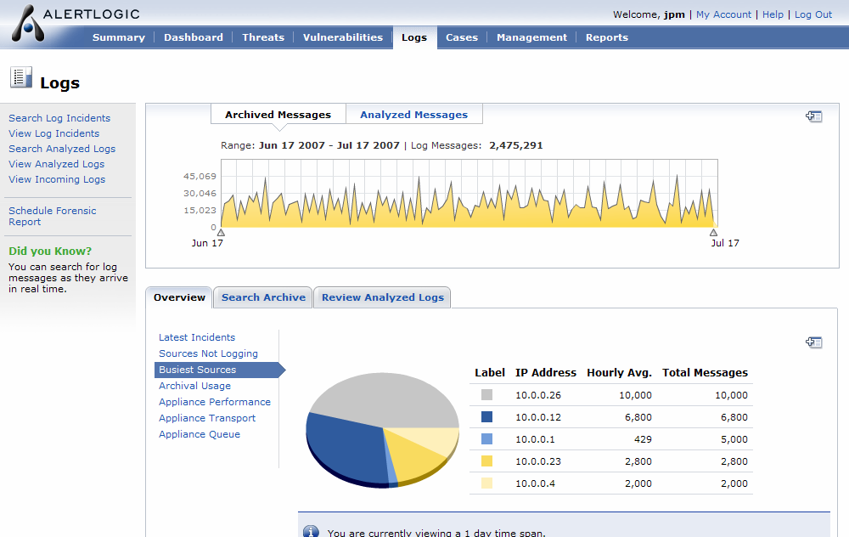
Log Sample with a tool

Slide 7
Cloud Challenges
The same Applications of Logs are relevant for The Cloud Deployments
System management & Network Management
For Service providers
SIEM
Forensics
Service providers and Customers
Auditing
Service providers and Customers
Regulations and Compliance (PCI, SOX, HIPPA)
Service providers and Customers

Slide 8
Cloud Challenges (contnd.)
Jul 7 00:03:15 192.168.23.1 %SEC-6-IPACCESSLOGP: list Oif-in denied tcp 66.43.204.165(4118) -> 255.255.255.255(111), 1 packet Jul 7 00:03:15 192.168.23.1 %SEC-6-IPACCESSLOGP:
We really can’t tell where 192.168.23.1 is located and which physical entity it’s associated with.
We also can’t tell what else on the same physical entity
We also can’t tell who has access to the same entity
User identity is obfuscated
This is a BIG problem for ANY application!!!

Slide 9
What we need to Support these Applications?
Track complete user interactions with cloud components
All activities should have complete audit trail from the initial request to the component, from authentication, impersonation if applicable, to the modification of the resource and the success or failure of the operation
Audit Real and Effective User Identities
All activities should be tracked with real (authenticated) and effective (impersonated) user identities.
Track Transit
Need to track the location of the entity that is involved in the activity. These locations could be highly dynamic, sometimes even temporary or short term resources. The audit trail should include a facility to track where requests originated, and any entity locations it passed through.

Slide 10
What we need to Support these Applications? (contnd.)
Use Syslog format
RFC 5424
STRUCTURED-DATA : SD-ELEMETs, SD-IDs, SD-PARAMs
Well defined, extensible, easy to understand and parse format
Define SD-ELEMENTS that are specific to Cloud Computing environment that would be mandatory for all
Allow providers and vendors to define heir own SD-ELEMENTS that will allow to log specifics about their implementations

Slide 11
What we need to Support these Applications? Some examples
Simple non-authenticated request will produce a log
Jul 7 09:01:40 10.0.6.94 api_aaa: AAA00000I [context@999999 aid="9BE817EB-8ACC-1004-D9DF-00000A00065E"][transit@999999 client="56.2.222.83"]
Where
SD-ID – ‘context@999999’
SD-PARAM - ‘aid’ – mandatory audit identifier
SD-ID - transit@999999
SD-PARAM – ‘client’ – mandatory IP of a client making a request (different from SD-ID ‘ip’ in RFC 5424 that defines IP of the entity producing the log)
SD-PARAM – ‘gw’ – optional The value is a concatenation of the string form of a UUID, identifying the gateway, a colon character (i.e. ':'), and finally the IP address on the gateway through which the request was received. It could be multiple ‘gw’ SD-PARAMS in the log.
The same request passing through the gateway
Jul 7 09:01:40 10.0.6.94 api_aaa: AAA00000I [context@999999 aid="9BE817EB-8ACC-1004-D9DF-00000A00065E"][transit@999999 client="56.2.222.83" gw="37CB88DB-8AE3-1004-CBED-00007F000001:10.0.11.9"]

Slide 12
What we need to Support these Applications? More examples
Failed Authentication
Jul 7 09:01:40 10.0.6.94 api_aaa: AAA00050I [context@999999 aid="9BE817EB-8ACC-1004-D9DF-00000A00065E"][transit@999999 client="10.0.6.94"] authentication failed, invalid password
Where
SD-ID – ‘context@999999’
SD-PARAM - ‘aid’ – mandatory audit identifier
SD-PARAM – ‘rid’ – optional parameter represents the real user identifier
SD-ID - transit@999999
SD-PARAM – ‘client’ – mandatory IP of a client making a request (different from SD-ID ‘ip’ in RFC 5424 that defines IP of the entity producing the log)
Successful Authentication
Jul 7 09:01:40 10.0.6.94 api_aaa: AAA00001I [context@999999 aid="9BE817EB-8ACC-1004-D9DF-00000A00065E" rid"2:510"][transit@999999 client="10.0.6.94"] authentication successful for cid = 2 uid = 510

Slide 13
What we need to Support these Applications? More examples
Invalid Request Parameter: request log -> response log
Request log:
Jul 7 09:01:40 10.0.6.94 inetsmgr: INM00150I [context@999999 aid="9BE817EB-8ACC-1004-D9DF-00000A00065E" rid"2:520" eid="1023:6022"][transit@999999 client="10.0.6.94"] "10.0.6.94" - "-" "GET /api/user/manager:search?customer_id=2&username=foo&bar=baz HTTP/1.1" 400 215
Response log:
Jul 7 09:01:40 10.0.6.94 umg: UMG00000I [context@999999 aid="9BE817EB-8ACC-1004-D9DF-00000A00065E" rid"2:520" eid="1023:6022"][transit@999999 client="10.0.6.94"] invalid query parameter "baz" specified on request
Where
SD-ID – ‘context@999999’
SD-PARAM - ‘aid’ – mandatory audit identifier
SD-PARAM – ‘rid’ – optional parameter represents the real (authenticated) user identifier
SD-PARM – ‘eid’ – optional parameter represents effective (impersonated) user identifier
SD-ID - transit@999999
SD-PARAM – ‘client’ – mandatory IP of a client making a request (different from SD-ID ‘ip’ in RFC 5424 that defines IP of the entity producing the log)

Slide 14
Proposed Next Steps
I believe that logging and auditability of the cloud and in the cloud is crucial for its adoption
These problems are not made up – heard it from several operators and customers
IETF’s job to support industry with interoperable and secure mechanisms
SO…..

Slide 15
Proposed Next Steps
Create a new WG or use already existing relevant one (if exists) to focus specifically on The Cloud
Cloud related work is different from the traditional static topology network:
Transitional and obfuscated identity ;
Managed entity location
Access to the shared resources
Resource multi-tenancy
Different type of security concerns – resource theft, diminished audit, detection, and incident response capabilities
And more…
Internet Drafts, deliverables, etc
By next meeting we’ll have “draft-gene-clouds-logging-00-src.txt”

