Slide 1
A carrier view on Cross Stratum
Telefónica Research
IETF 80 Meeting
29 Mar. 2011, Prague (Czech Republic)
Javier Jiménez (fjjc@tid.es)
0
Telefónica Servicios Audiovisuales S.A. / Telefónica España S.A.
Título de la ponencia / Otros datos de interés / 26-01-2010
Telefónica Investigación y Desarrollo

Slide 2
The potential of Cross Stratum Optimization
Cloud Computing (IaaS, PaaS, SaaS) has become a revolutionary new business for traditional IT providers, and network operators.
Cloud provides IT services for business customers from a datacenter, but also ensuring a proper network connectivity between the client/datacenter/Internet.
Key question: do Telcos have any potential advantage?
If any, the answer is: cross-stratum optimization…
…but what does CSO really mean?
On-demand network provisioning in support for Cloud Services?
Application aware networks? Enhanced QoS? Improved flexibility?
An IETF working group on Cross Stratum Optimization should provide the tools to support cross-layer interactions between the Cloud service layer and the Network.

Slide 3
On-demand network provisioning API
Service-aware interface between the network and the Cloud.
On-demand connectivity provisioning.
Service modification.
Service status monitoring.
Cross-layer resiliency.
Cloud
Operator
Corporate
User
1 – Cloud Scaling Request
Cloud Middleware
Web
Front End
Potential applications:
Bundled Cloud+Network services.
Differentiated network services for third-parties.
Flexible Cloud services.
Catalyst for BoD, dynamic VPNs.
Special short-term focus: IP/MPLS transporting traffic aggregates.
CPE
5- Confirmation
2- Network Service Request
4- Confirmation
3- Client Profile
Configuration
Edge Node
Network Service Manager
3- Network
Configuration
Border
Node
Network
Operator
Workflow

Slide 4
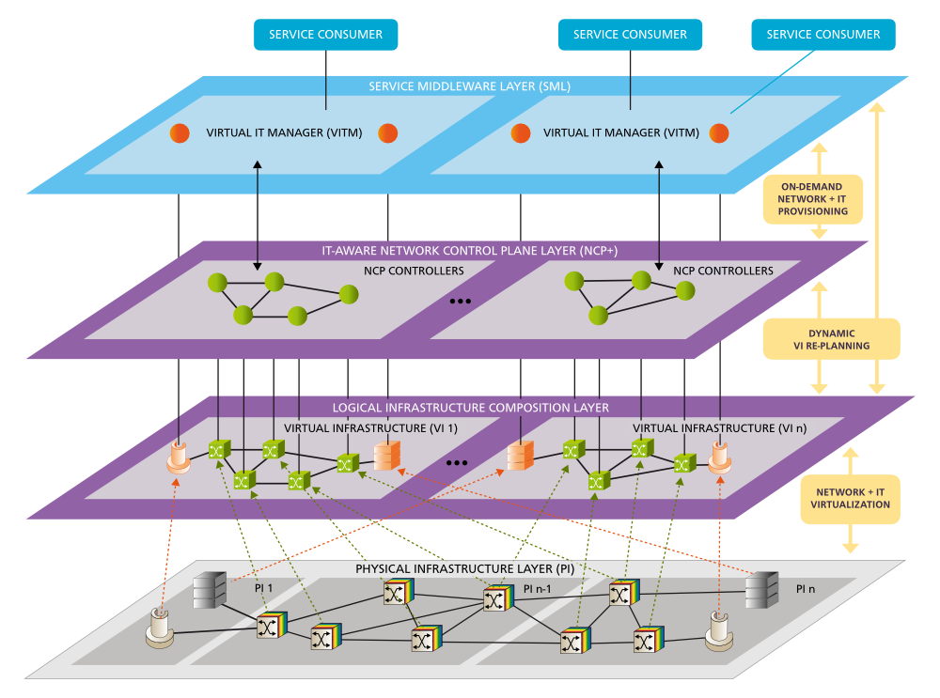
Optical as a Service
Next step: Generalize cross-stratum concepts for optical networks.
OaaS: The optical network as a composable service in the Cloud ecosystem.
A first approach: GEYSERS Project
EC Funded initiative.
Running 2010-2012.
7M€, 26 FTE / year.
Focus on:
Optical Network Virtualization.
NET+ IT Joint Provisioning.
www.geysers.eu

Slide 5
The GEYSERS approach
www.geysers.eu
Dynamic on-demand provisioning of network and IT resources in a single-step, through a set of seamlessly integrated procedures.
Service Middleware Layer
IT Manager
NIPS = Network + IT Provisioning Service
NIPS Client
IT service coordination
IT resources management
NIPS UNI
Centralized NIPS Server in each routing domain
Offering a CP service interface for NaaS
Network Control Plane
PCE +
NIPS Server
GMPLS controllers
Datacenter
Network

Slide 6
NIPS Interface
www.geysers.eu
A Service-to-Network interface providing different services:
Unicast: on demand network connection → traditional BoD.
Assisted unicast: quotation about cost/performance of [src,dst] pairs → network query.
Restricted anycast: selection from a set of end-points → network-centric query+BoD.
Anycast: IT end-points selection fully delegated to the NCP → IT-aware routing!
Besides, cross-layer escalation of monitoring and recovery procedures.
NIPS functionalities
NIPS requests for service life-cycle management
Setup
Modification
Tear-down
IT resources advertisement
Capabilities
Availabilities
Green parameters
Monitoring
Status queries
Notifications (failures, restorations)

Slide 7
In brief...
Once upon a time, cross-layer IP over WDM optimization provided new ideas on the way completely different networks could be integrated.
IT/Network CSO will eventually follow the same slow, but paced path.
An integration of network & cloud would be of great benefit for Telcos.
A CSO WG should provide a common standardized framework.
The scope is still quite open, but a lot of work is already in place.

Slide 8
abcedefghijklmnñopqrstuvwxyz
ABCDEFGHIJKLMNOPQRSTUVWXYZ
123456789~$¨´Ç`+%&()=?¡ *^][}{-_;:,º\/
abcedefghijklmnñopqrstuvwxyz
ABCDEFGHIJKLMNOPQRSTUVWXYZ
123456789~$¨´Ç`+%&()=?¡ *^][}{-_;:,º\/
abcedefghijklmnñopqrstuvwxyz
ABCDEFGHIJKLMNOPQRSTUVWXYZ
123456789~$¨´Ç`+%&()=?¡ *^][}{-_;:,º\/
Notes:
7

