Slide 1
How to Create an Internet-Draft Using Markdown
24 March 2019
Prague
Dan York – york@isoc.org

Slide 2
Why Markdown?
Because this...
--- middle
# Introduction
Here is some intro text.
is easier for most people to understand than this...
<middle>
<section title="Introduction">
<t>Here is some intro text.</t>
</section>
</middle>

Slide 3
What is Markdown?
Lightweight text formatting language
Developed by John Gruber in 2004 with help from Aaron Swartz
https://daringfireball.net/projects/markdown/
Inspired by customs and conventions emerging out of text-based email
"The overriding design goal for Markdown’s formatting syntax is to make it as readable as possible. The idea is that a Markdown-formatted document should be publishable as-is, as plain text, without looking like it’s been marked up with tags or formatting instructions."
"The idea for Markdown is to make it easy to read, write, and edit prose. HTML is a publishing format; Markdown is a writing format."

Slide 4
Markdown example
# First level heading
Some text
## Second level heading
- first bullet with _italic text_ - second bullet with **bold text** - third bullet
### Third level heading
Visit [the IETF's website](https://www.ietf.org)
## Second level heading
(you get the idea...)

Slide 5
Comparison of Markdown to other formats
RFC 7764 has this useful chart:

Slide 6
The many flavors of Markdown
"Original" from John Gruber
MultiMarkdown
GitHub Flavored Markdown (GFM)
pandoc
kramdown
Fountain
CommonMark
An attempt at standardizing Markdown by a group of advocates
www.commonmark.org
MANY other variants...

Slide 7
The text/markdown media type and an IANA Registry
Informational RFC7763 (March 2016):
registers the text/markdown media type
defines a "Markdown Variants" registry established by IANA
registers "Original" in that new registry
IANA Registry at:
https://www.iana.org/assignments/markdown-variants/markdown-variants.xhtml

Slide 8
RFC 7764
Informational RFC in March 2016
https://tools.ietf.org/html/rfc7764
Title: "Guidance on Markdown: Design Philosophies, Stability Strategies, and Select Registrations"
A good read to understand more about Markdown
Registers with IANA:
a number of common Markdown variants, including:
kramdown-rfc2629
RFC7328 - Pandoc2rfc

Slide 9
Building an Internet Draft using Markdown
At a basic level, the various tools do this:
1. Take a markdown file and generate "xml2rfc" XML
Originally often called "RFC 2629 XML", but then later defined in RFC 7749 "xml2rfc v2" and now RFC 7991 "xml2rfc v3”
2. Run "xml2rfc" on the resulting XML to generate TXT

Slide 10
First step: choosing your markdown toolchain
Kramdown-rfc
https://github.com/cabo/kramdown-rfc2629
Developed in Ruby by Carsten Bormann
Can be used online at: https://xml2rfc.tools.ietf.org/experimental.html
mmark
https://github.com/miekg/mmark
Developed in Go by Miek Gieben
Supported by Docker image from Paul Jones: https://github.com/paulej/rfctools
This tutorial today will only cover kramdown-rfc

Slide 11
Getting Started with kramdown-rfc (locally)
Assuming your computer has Ruby, install the kramdown-rfc2629 package: gem install kramdown-rfc2629
Create your file using your favorite text editor
Many "markdown editors" also available
Convention is to end file with .md or .mkd
Just execute the kdrfc command:
$ kdrfc draft-whomever-some-witty-name.md
Output is two files: .xml and .txt
More info: https://github.com/cabo/kramdown-rfc2629

Slide 12
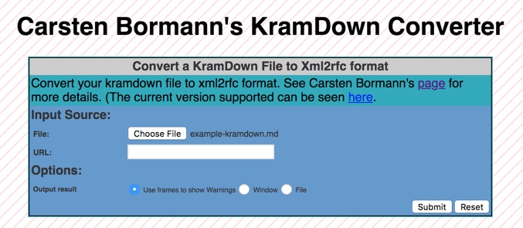
Getting started with kramdown remotely
Create your file using your favorite text editor
Visit https://xml2rfc.tools.ietf.org/experimental.html
Find the kramdown converter box:
Choose file and submit for processing.
The XML file will be downloaded to your computer.
NOTE: The XML file name is currently same name as input file, including .md extension.

Slide 13
Kramdown-rfc notes
Based on kramdown parser by Thomas Leitner. Syntax:
https://kramdown.gettalong.org/syntax.html
File starts with ---
Header uses YAML. Example:
title: Your amazing title
abbrev: Your Abbreviation
docname: draft-todo-your-name-here
ipr: trust200902
area: General
author:
ins: C. Bormann
name: Carsten Bormann
email: cabo@tzi.org
References:
Normative: {{!RFC2119}} or Informative: {{?RFC1925}}

Slide 14
Finding markdown examples to get started
Easiest way to begin is to find other people's Markdown I-Ds
Examples provided in Dan York’s tutorial Github repos of both kramdown-rfc and mmark
For people wanting a deeper dive:
Martin Thomson provides a thorough git repo:
https://github.com/martinthomson/i-d-template
See features: https://github.com/martinthomson/i-d-template/blob/master/doc/FEATURES.md
Supports files in both kramdown-rfc and mmark formats

Slide 15
Final thoughts
Markdown provides an easy way to rapidly create Internet Drafts without needing to know XML
Markdown tools can be used to generate XML if you want to then work more in XML
Tools can only do Markdown -> XML
Some people who work in XML use Markdown as a way to bootstrap the creation of their XML files
Markdown can be extended by embedding XML snippets (for example, if you want to use some feature in XML that is not yet in Markdown)
The ecosystem of tools, apps, services, and sites that support Markdown continues to expand

Slide 16
Resources
RFC 7763 - https://tools.ietf.org/html/rfc7763
RFC 7764 - https://tools.ietf.org/html/rfc7764
Carsten Bormann’s repository:
https://github.com/cabo/kramdown-rfc2629
Dan York’s tutorial information:
https://github.com/danyork/writing-internet-drafts-in-markdown

Slide 17
Questions or suggestions?
Rfc-markdown mailing list:
https://www.ietf.org/mailman/listinfo/Rfc-markdown
RFC Editor:
rfc-editor@rfc-editor.org or stop by the desk this week
Please complete a short survey about this tutorial:
[[https://www.surveymonkey.com/r/104tools]]

