Slide 1
GETTING THERE FROM HERE
30 in 2020 in the Democratic Republic of Congo
Lee W McKnight
Syracuse University iSchool
Katcho Karume
Goma Volcano Observatory (OVG)
Yihan Yu
Syracuse University WiTec
Image courtesy katalogwisata.com
Mt. Nyiragongo, Goma,
Democratic Republic of Congo
Paper prepared for presentation at: 45th TPRC Research Conference on Communications, Information and Internet Policy, George Mason University School of Law, Arlington, Virginia, September 8-9, 2017

Slide 2
We are Virtually Here
Hypothesis:
Conflict Zones CAN become Innovation Zones
Methods:
Education & multi-stakeholder dialogue
Internet Backpack beta technical and user evaluation
Innovation Zone Checklist policy evaluation
Test: National Digital Transformation
30% by 2020?

Slide 4
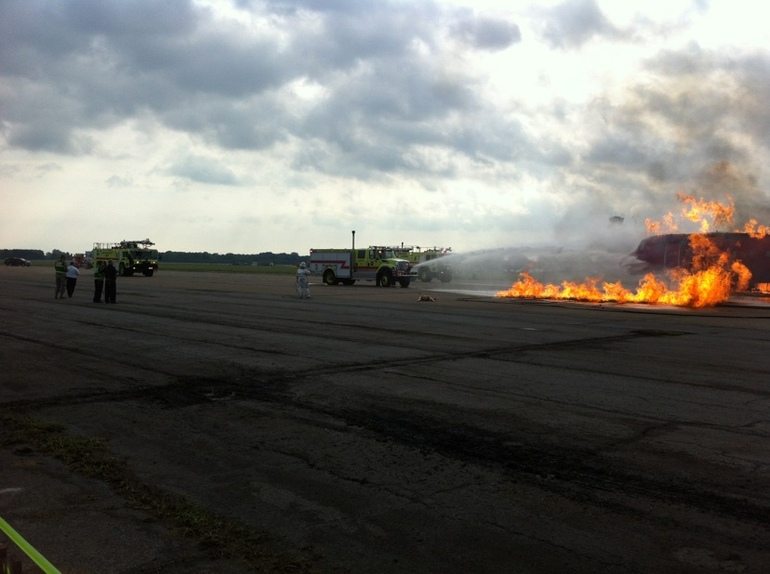
Worldwide Innovation Technology and Entrepreneurship Club ← Wireless Grid Innovation Testbed
Secure IoT (needs permissions)
“Symphony of Destruction,” August 2012; 45 Public Safety Agencies + Syracuse University National Science Foundation Partnerships for Innovation WiGiT Project “Intelligent Deployable Augmented Wireless Gateway”

Slide 5
Edgeware
Software platforms that reside beyond the cloud, across edge network devices, wired and wireless. (IoT/5G+)
Edgeware allows all facets of a user’s environment to be interoperated and shared easily.
Notes:
Sharing capabilities

Slide 6
Cloud to Edge Security Compliance WiTec Open Specifications Model v0.4
Source: TM Forum Enterprise Cloud Leadership Council ‘Workplace as a Service Architecture’ Baltimore, July 17, 2012

Slide 7
How to Get There From Here: Innovate
Unlicensed/Shared Services/New Entrant Experimental License & Fast Frequency Allocation at ALL Frequencies Specified Below Permitted in Province _________ | Accelerate economic growth, open innovation, Increase competition, lower prices, improve service quality | Yes | In Process | No
900 MHz | Accelerate open innovation, Improve service quality | Yes | In Process | No
2.4 GHz | Accelerate open innovation, Improve service quality | Yes | In Process | No
3.5 GHz | Accelerate open innovation, Improve service quality | Yes | In Process | No
5 GHz | Accelerate open innovation, Improve service quality | Yes | In Process | No
24 GHz | Accelerate open innovation, Improve service quality | Yes | In Process | No
60 GHz | Accelerate open innovation, Improve service quality | Yes | In Process | No
80 GHz | Accelerate open innovation, Improve service quality | Yes | In Process | No
90 GHz | Accelerate research and open innovation, Improve service quality | Yes | In Process | No

Slide 8
DRC 30 in 2020 Innovation Zone Checklist-FINAL Inter-Agency Task Force and Advisory Group https://www.iatag.org/
PROVINCE/REGION_______________________
DATE_______________
COMPILED BY (NAME/CONTACT INFORMATION) __________________________________________________
AUTHORIZED SIGNATURE: GOVERNOR___________________
MULTI-STAKEHOLDER CO-SIGNER,1______________________
MULTI-STAKEHOLDER CO-SIGNER 2______________________
Instructions: Please confirm your Province has completed all of the following 24 Milestones (unlikely). Alternatively, describe the stage of Innovation Zone Readiness your Province has achieved on each of the Milestones by checking a ‘Ready or Not?’ box as indicated below. In addition to completing the Innovation Zone Checklist, further documentation of your Province’s readiness may be attached as appendices.

Slide 9
Milestone | Rationale | Ready or Not? Readiness Assessment (Select One)
Governor, Agencies, Advisory Group Agree: Province now an Innovation Zone | Both leadership and ‘rough social consensus’ needed for progress | Yes | In Process | No
1st DRC Internet Forum Provincial Multistakeholder Participation | Share information across firms, agencies, regions, communities | Yes | In Process | No
Emergency preparedness | Increase community readiness with improved coordination of information | Yes | In Process | No
Environmental health emergency preparedness | Enhance access to disease prevention information especially with disasters | Yes | In Process | No
Community networks supported | Accelerates access, lowers cost, increases engagement and adaptive use, builds demand | Yes | In Process | No
Educational networks supported | Enable student access to improve learning outcomes and career readiness, begin to grow regional interconnected network backbones | Yes | In Process | No
Infrastructure gap analysis | Identify barriers to economic growth, suggest remedies | Yes | In Process | No

Slide 10
Mobile backhaul, tower, pole attachment, Rights of Way, fiber, RF, data center, energy infrastructure-sharing authorized/encouraged | Enhance user experience, increase service efficiency, reduce cost and risk for new entrants, incumbents | Yes | In Process | No
IP traffic aggregation regional strategy implemented | Lowers cost, improve services | Yes | In Process | No
Security awareness training | Increase organizational readiness | Yes | In Process | No
Law & policy review | Identify ways to streamline procedures across agencies for new service acceleration in Innovation Zone Provinces | Yes | In Process | No
Market analysis | Review barriers to market access and efficiency | Yes | In Process | No
Environmental assessment | Ensure negative impacts on environment are avoided or minimized | Yes | In Process | No
Social innovation and entrepreneurship | Is community open to entrepreneurs and community organizations | Yes | In Process | No
Regional and international cooperation opportunities | Review ways to collaborate more closely with neighboring Provinces, Nations, NGOs, civil society, and firms to attain UN Sustainable Development Goals | Yes | In Process | No

Slide 11
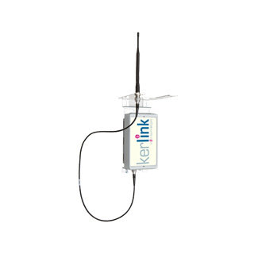
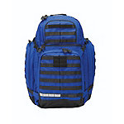
Internet Backpack Be Prepared
Comes with:
CEG
Microsoft Azure Cloud
See: www.wigridco.com

Slide 12
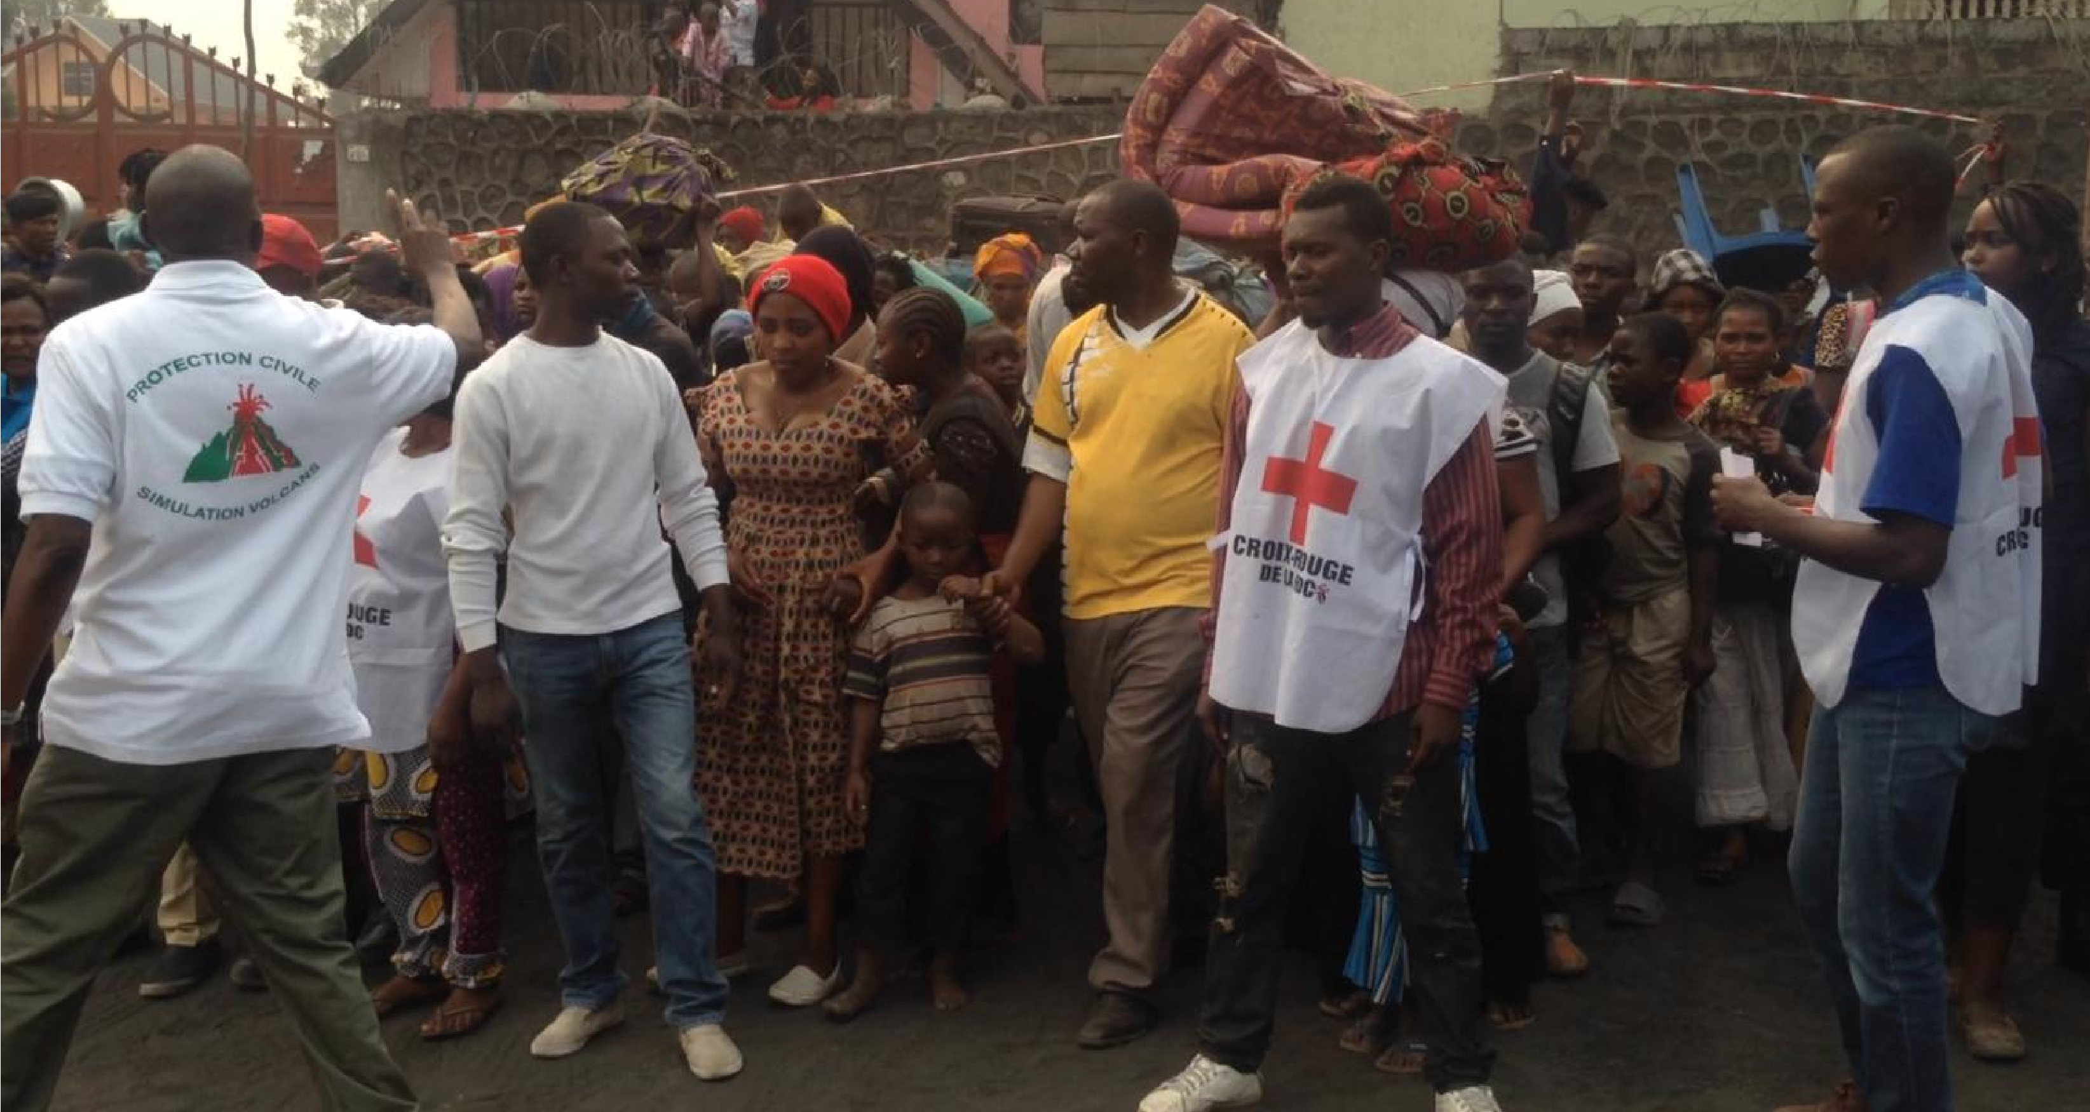
This Is Only a Test: Emergency Response Training Goma, Democratic Republic of Congo, June 2017

Slide 13
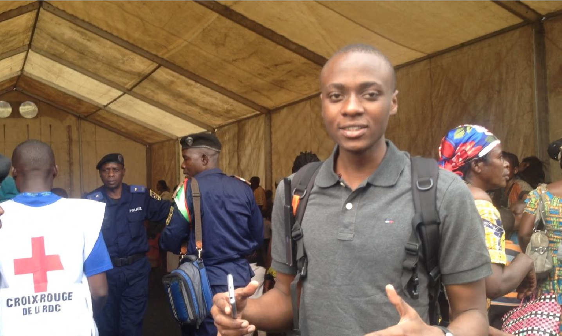
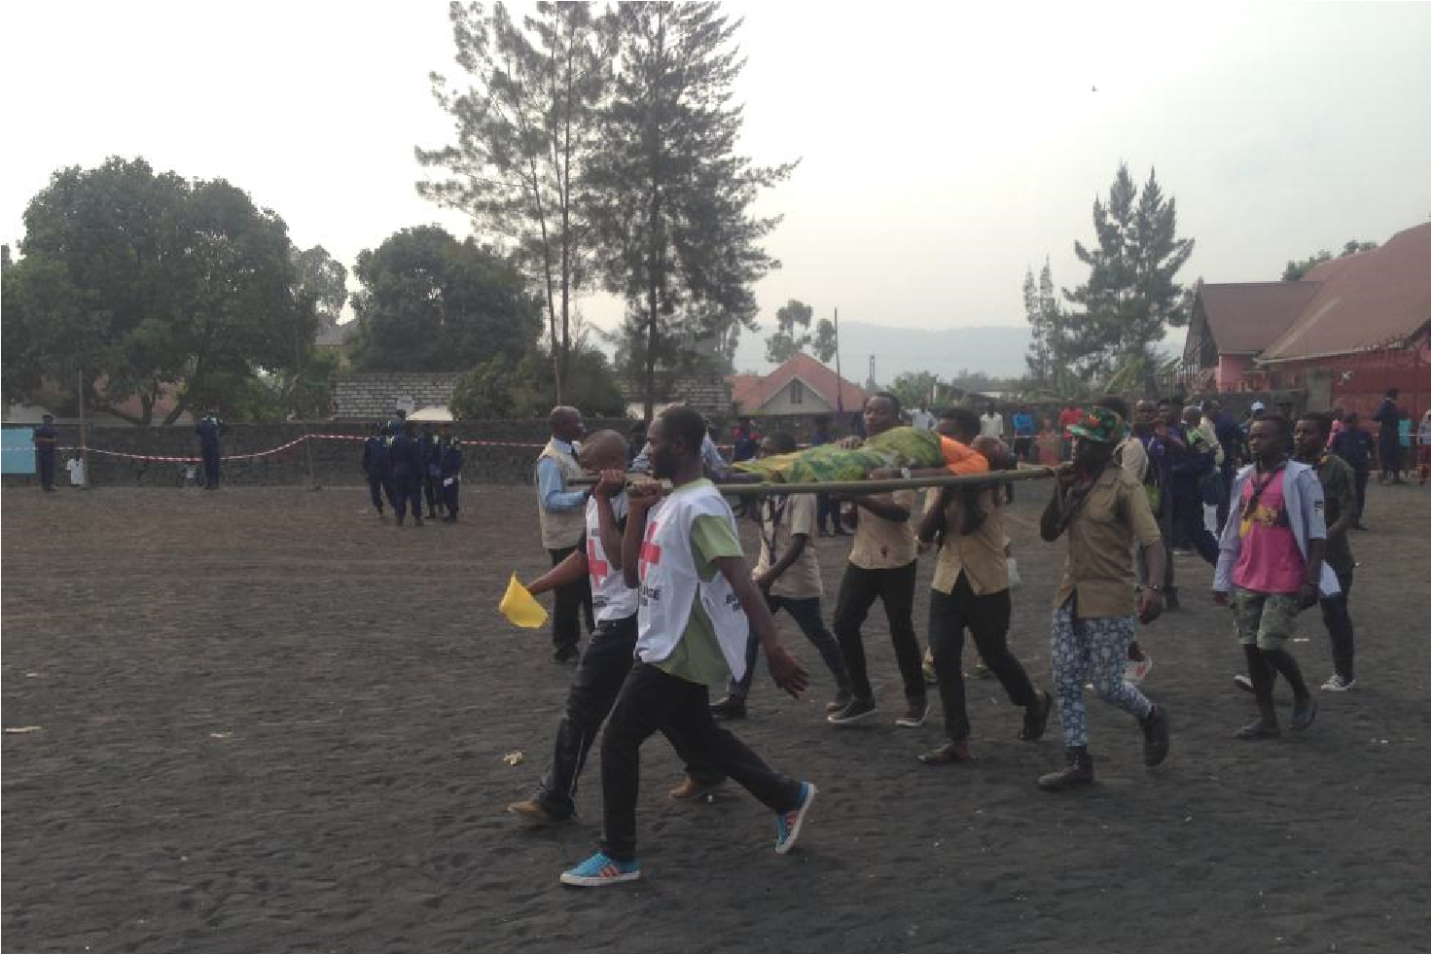
5,000 person volcano emergency response training + 1 Internet Backpack Beta =
2 Thumbs Up : )

Slide 14
Current Status
Goma Volcano Observatory continues to provide valuable feedback on user experience with beta Internet Backapck.
5 Governor’s volunteering Provinces as Innovation Zones
Innovation Zone Checklist translated to French
1st Democratic Republic of Congo Internet Forum
Feb. 22-23, 2018, Goma, North Kivu
Firms, foundations, university partners, DRC agencies, provinces
Internet of Things STEM education partnership/OPEN
Texas A&M & Syracuse U developing project plans
DRC Inter-Agency Task Force and Advisory Group expanding – want to help? See: www.iatag.org
Liberian Ministry of Education visits Syracuse next week
‘30 in 2021’ plan in discussion; 1st Liberian IF June 2018 (tent.)
Uganda, Kenya, Haiti interest

