Slide 1
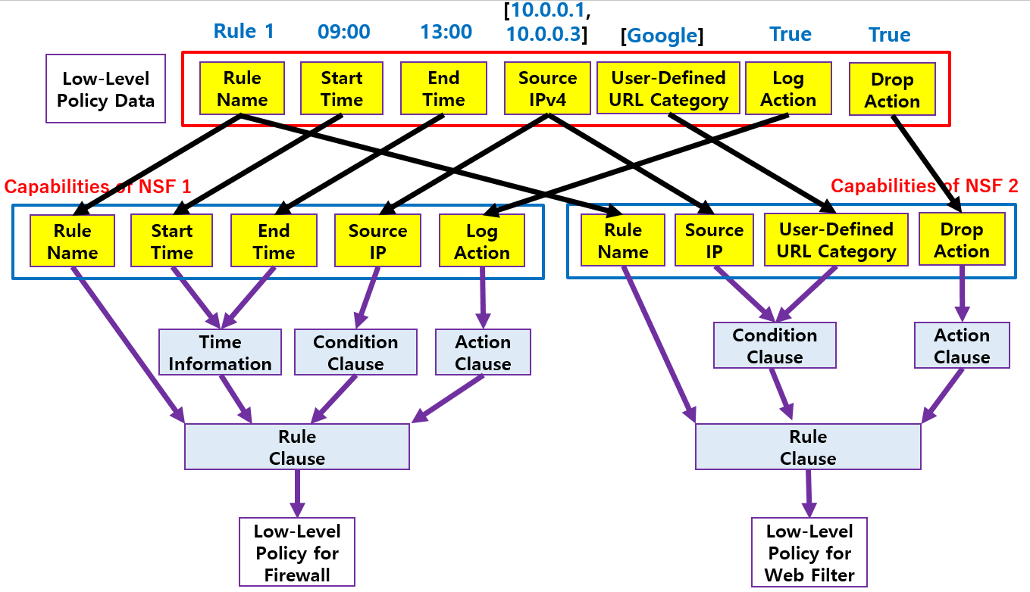
I2NSF (Interface to Network Security Functions) Framework Project
Champion: Jaehoon Paul Jeong (SKKU)
Where to get code
Github – Source Code
https://github.com/kimjinyong/i2nsf-framework
What to pull down to set up an environment
OS: Ubuntu 16.04 LTS
ConfD for NETCONF: 6.6 Version
Apache2: 2.4.7 Version
MySQL: 14.14 Version
PHP: 5.5.9 Version
OpenStack: Networking-SFC and Tacker
Manual for Operation Process
Detailed description about operation process in README.txt (It can be found in Open Source Project folder.)
IETF-104 Hackathon
I2NSF Architecture in NFV Reference
I2NSF Framework Project
Professors
Jaehoon Paul Jeong (SKKU)
Hyoungshick Kim (SKKU)
Sangwon Hyun (Chosun University)
Collaborators
Jung-Soo Park (ETRI)
Tae-Jin Ahn (Korea Telecom)
Security Policy Translation
Contents of Implementation
I2NSF Framework for Network Security Functions (NSFs)
Registration Interface via NETCONF/YANG (New Feature)
NSF-Facing Interface via NETCONF/YANG
I2NSF Framework in OpenStack NFV Environment
NSF Database Management via Consumer-Facing Interface (New Feature)
Interface Data Model Auto-Adoption (New Feature)
Network Security Functions
Firewall and Web-filter using SDN and Suricata
Advanced Functions
Security Policy Translation
NSF-triggered Traffic Steering in OpenStack SFC Function (New Feature)
I2NSF Policy Provisioning using Decision Tree (New Feature)
Students
Jinyong Tim Kim (SKKU)
Jinhyuk Yang (SKKU)
Chaehong Chung (SKKU)

