Slide 1
Export BGP community information in IP Flow Information Export (IPFIX) draft-li-opsawg-ipfix-bgp-community-00
Zhenqiang Li
Rong Gu (Presentor)
Jie Dong

Slide 2
Background
Traffic Engineering/Traffic Steering/Traffic load balancing
Network administrators needs to get the flow information with amount and direction of traffic in their network in order to realize the network optimization.
IPFIX is designed for exporting formatted IP flow information
Flow information is transferred from an exporter to a collector with information elements defined in [IANA-IPFIX]
sourceIPv4Address / destinationIPv4Address
sourceTransportPort / destinationTransportPort
bpgSourceAsNumber / bgpDestinationAsNumber
etc.

Slide 3
BGP Community Based Flow Information
For traffic engineering in operators’ backbone networks, flow information based on the existing IEs is not always suitable
Flow information based on IP address or IP prefix is meticulous.
Flow information based on AS numbers is too coarse.
BGP community can provide the suitable flow granularity
Describes a group of routes sharing some common properties
Flow information based on BGP community needs to be exported using IPFIX
➔Up to now, no existing IE is defined for BGP community information.

Slide 4
Application
Architecture 1
Exporter
Mediator
Collector
hold the up-to-date BGP routing table
look up in the BGP routing table
hold the up-to-date BGP routing table
look up in the BGP routing table
Collect the flow information
based on BGP community
bgpSourceAsNumber
bgpDestinationAsNumber
bgpNextHopIPv4Address
…existing IEs
Correlating BGP community with the flow information by matching the route for the specific flow
New IEs for BGP community
Architecture 2
Exporter
Collector
hold the up-to-date BGP routing table
look up in the BGP routing table
Collect the flow information based on BGP community
bgpSourceAsNumber
bgpDestinationAsNumber
bgpNextHopIPv4Address
…
New IEs for BGP community

Slide 5
IE definition
Two information elements are defined in order to export the BGP community information.
bgpSourceCommunityList
bgpDestinationCommunityList
Both IPv4 and IPv6 traffic are applicable.
Both exporter and mediator can use these two IEs to export BGP community information in IPFIX.

Slide 6
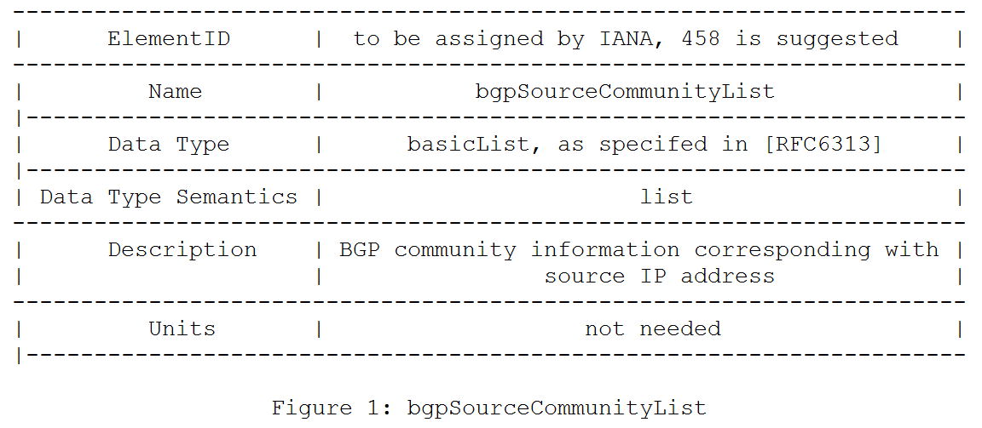
IE definition: bgpSourceCommunityList
bgpSourceCommunityList with its data type semantics listed as follows.
Notes:
two information elements needed in exporting BGP community information along with other flow information defined by IPFIX. Information elements description and their data type semantics are listed below.

Slide 7
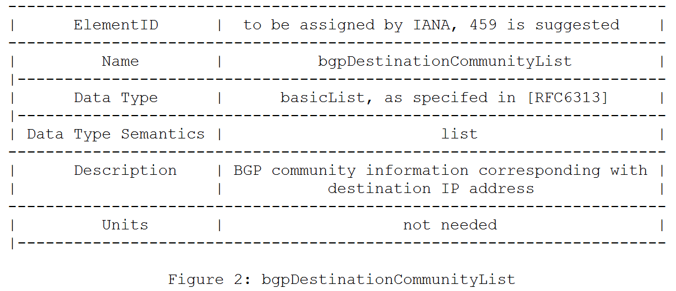
IE definition: bgpDestinationCommunityList
bgpDestinationCommunityList with its data type semantics listed as follows.

Slide 8
Next steps
See if other operators have similar requirements
Solicit comments and contributions to improve this draft
Work group adoption ?

Slide 9
MANY THANKS
Zhenqiang Li
lizhenqiang@chinamobile.com
Rong Gu
gurong@chinamobile.com
Jie Dong
jie.dong@Huawei.com

