Slide 1
Cybersecurity information security exchange framework (CYBEX): importance and current developments
ISOG-J Seminar
IBM Japan building
Tokyo, 13 Oct 2010
V1.1
Tony Rutkowski, tony@yaanatech.com
Rapporteur for Cybersecurity Group, ITU-T Q4/17
Additional roles include: global eWarrant Rapporteur, ETSI TCLI; U.S. NSTAC Cybersecurity Expert; Distinguished Senior Research Fellow, Georgia Institute of Technology

Slide 2
Outline
Why the CYBEX initiative is important
Major developments shaping the work
Specific capabilities
Systems Assurance and Incident Response
Cybersecurity Information Exchange Framework
Identity Management
Major implementation challenges
Extent and evolution of the standards
Discovery and trust capabilities
Achieving implementations and widespread use

Slide 3
CYBEX: origins
A common realization that
Talking about cybersecurity accomplished nothing
The incidents were scaling exponentially
Trusted exchange of cybersecurity information was essential to any/all capabilities
Many different communities were developing cybersecurity information exchange schema
No global framework and consensus existed to bring together communities and schema
Institutional triggers
ITU-T began a new 4 year cycle with a mandate to do something about cybersecurity
Participants found there were common global interests in tackling cybersecurity information exchange challenges
LAC, NICT, and other Japanese experts and organizations
Government and industry entities in APEC region, U.S., and Europe

Slide 4
Agreement on a cybersecurity model: information sharing dependencies
Intergovernmental agreements and cooperation
Contractual service agreements and federations
Encryption/ VPNs esp. for signalling
Measures for protection
Tort & indemnification
Legal Remedies
Legal remedies may also institute protective measures
Real-time data availability
Resilient infrastructure
Regulatory/ administrative law
Measures for threat detection
Criminal law
Data retention and auditing
Provide basis for legal remedies
Forensics & heuristics analysis
Provide data for analysis
Identity Management
Routing & resource constraints
Provide basis for actions
Investigation & measure initiation
Blacklists & whitelists
Deny resources
Reputation sanctions
Patch development
Provide awareness of vulnerabilities and remedies
Network/ application state & integrity
Vulnerability notices
Measures for thwarting and other remedies
Information exchanges

Slide 5
Platform coherency appeared possible
Identity Management
Providers
Persons
Objects
System
Integrity
Incident
Forensics
Assurance
Enforcement Forensics

Slide 6
Providing outreach among standards bodies seemed possible
ITU-T
ETSI
ITU-R
CCDB
3GPP
ISO
OMA
CAB forum
MITRE
CNIS
TCG
FIRST
IMS forum
IEEE
WiFi Forum
IETF
NIST
APWG
OASIS
APP Dev
Forums
Cable
Labs

Slide 7
Major related institutional developments
U.N. 15 July document among 15 major powers on reducing “ICT conflict” (a/k/a cyberwar)
Exercise of cybersecurity authority by regulatory bodies
e.g., Korea, FCC in U.S.
High Level Cybersecurity Strategies (USTIC, Japan, UK, China, Korea)
Cybersecurity as an issue at ongoing ITU Plenipotentiary Conference
Enhanced Common Criteria Development Board (CCDB)/NATO activity
New real-time, data retention, and mobile forensics mandates offshore
Judicial eDiscovery mandates (e.g., FRCP Rule 26) in US and offshore

Slide 8
Major related infrastructure developments
Application based infrastructure
Mobile platforms driving a world of a million applications
Poses major challenges (what is a good application versus malware)
Locator/ID Separation Protocol (LISP)
Re-architects IP based public infrastructures
Should solve significant ICT security related challenges, especially attribution
Asia-Pacific-centricity
Region has world’s largest and fastest growing infrastructure and strong economies
Pursuing technology implementations, network innovations, venue leadership
Mobile/nomadic-centricity
Stressing mobile standards/collaborative forums
Include multiple IdM/cyber security challenges

Slide 9
CYBEX is a substantive ongoing global Cyber/ICT security initiative
Aimed at achieving meaningful security
"lock down" the integrity of ICT systems,
watch for undesired incidents, and
capture, analyze, and process the forensics from those incidents to reduce vulnerabilities, thwart attacks, and institute legal action if appropriate
The trusted exchange of information is essential to accomplish these three tasks.
The Cybersecurity Information Exchange Framework (CYBEX) initiative aimed at identifying the emerging set of specifications for the global platforms for achieving these trusted exchanges
Most of the work has been accomplished within existing systems assurance, incident response, and intelligence/surveillance communities
Pro-active outreach is part of the initiative
Constant attempt to survey what is occurring in all other forums and bringing important capabilities into the framework
Constant analysis of what is missing or needed
Unique – no comparable activity exists

Slide 10
CYBEX Exchange Model
Cybersecurity
Entities
structuring cybersecurity information for exchange purposes
identifying and discovering cybersecurity information and entities
requesting and responding with cybersecurity information
exchanging of cybersecurity information over networks
assuring cybersecurity information exchanges
Cybersecurity
Entities
Cybersecurity Information acquisition
(out of scope*)
Cybersecurity Information use
(out of scope*)
* Some specialized cybersecurity exchange implementations may require application specific frameworks specifying acquisition and use capabilities

Slide 11
CYBEX Ontology
Incident Handling Domain
Knowledge Accumulation Domain
Warning Database
Cyber Risk KB
Coordinator
Vulnerability KB
Threat KB
Researcher
Incident Database
Attack KB
Mis-use KB
Response Team
Event
Incident
Attack
Countermeasure KB
IT Asset Management Domain
Assessment Rule
Detection / Protection Rule
Registrar
Administrator
Asset Database
Internal Asset DB
Product KB
Version KB
External Asset DB
Configuration KB
Network Operator
Vendor

Slide 12
Information Exchange Structuring
Vulnerability/State Exchange Cluster
Event/Incident/Heuristics Exchange Cluster
Knowledge Base
Platforms
Weaknesses
Vulnerabilities and Exposures
Event Expressions
Malware Patterns
State
Incident and Attack Patterns
Security State Measurement
Configuration Checklists
Assessment Results
Extensions for:
DPI
Traceback
Smartgrid
Phishing
Evidence Exchange Cluster
Terms and conditions
Handover of real time forensics
Handover of retained data forensics
Electronic Evidence Discovery

Slide 13
XCCDF
eXensible Configuration Checklist Description Format
OVAL Open Vulnerability and Assessment Language
CVSS
Common Vulnerability Scoring System
CWSS Common Weakness Scoring System
Weaknesses, Vulnerabilities, & State
CPE Common Platform Enumeration
CCE Common Configuration Enumeration
ARF
Assessment Result Format
CVE Common Vulnerabilities and Exposures
CWE Common Weakness Enumeration
IODEF Incident Object Description Exchange Format
CAPEC Common Attack Pattern Enumeration and Classification
CEE Common Event Expression
Events, Incidents, & Heuristics
Information Exchange Schema
Application Specific Extensions

Slide 14
XCCDF
eXensible Configuration Checklist Description Format
OVAL Open Vulnerability and Assessment Language
CVSS
Common Vulnerability Scoring System
CWSS Common Weakness Scoring System
Weaknesses, Vulnerabilities, & State
CPE Common Platform Enumeration
CCE Common Configuration Enumeration
ARF
Assessment Result Format
CVE Common Vulnerabilities and Exposures
CWE Common Weakness Enumeration
IODEF Incident Object Description Exchange Format
CAPEC Common Attack Pattern Enumeration and Classification
CEE Common Event Expression
Events, Incidents, & Heuristics
Information Exchange Schema - Malware
MAEC Malware Attribution Enumeration and Characterization
Application Specific Extensions

Slide 15
XCCDF
eXensible Configuration Checklist Description Format
OVAL Open Vulnerability and Assessment Language
CVSS
Common Vulnerability Scoring System
CWSS Common Weakness Scoring System
Weaknesses, Vulnerabilities, & State
SCAP Security Automation Tools
CPE Common Platform Enumeration
CCE Common Configuration Enumeration
ARF
Assessment Result Format
CVE Common Vulnerabilities and Exposures
CWE Common Weakness Enumeration
IODEF Incident Object Description Exchange Format
CAPEC Common Attack Pattern Enumeration and Classification
CEE Common Event Expression
Events, Incidents, & Heuristics
Information Exchange Schema – SCAP Application
Application Specific Extensions

Slide 16
Information Exchange Trust capabilities
Discovery of parties, standards, schema, enumerations, instances and other objects
Common Namespace
Discovery enabling mechanisms
Request and distribution mechanisms
Identity Assurance Cluster
Exchange Cluster
Trusted Platforms
Authentication Assurance
Methods
Authentication Assurance Levels
Trusted Network Connect
Interaction Security
Transport Security

Slide 17
CYBEX Implementation
Exchange Policies
Exchange Policies
Exchange Requests
Exchange Requests
Weaknesses, Vulnerabilities & State Information
+
Events, Incidents, & Heuristics Information
+
Evidence Information
Security Automation Schema
Incident Detection Schema
Trusted Network Connect
Tools
Tools
Software, systems, services, networks
Trusted Platform Modules

Slide 18
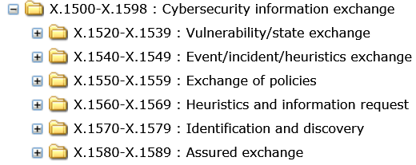
So where do we go from here: the challenges
An entire ITU-T Recom- mendation X-series has been allocated
Recs. X.cybex, X.cve, X.cvss should be approved in December
Future of IODEF remains a question mark
Many additional CYBEX pieces are in various stages of preparation for adoption during 2011-2013 and subsequent maintenance
A global structured website of cybersecurity organizations has been created on ITU-T website
Substantial challenges remain…

Slide 19
Challenge: Extent and evolution of CYBEX Recommendation
Is the framework currently complete?
What standards should be included in the framework? What are the criteria for inclusion?
Which standards get published as ITU-T Recommendations and which do not?
How do ITU-T published versions maintain “sync” with authoritative community versions?
How do regional and national variants/schemas become included?
How should Security Content Automation Protocol (SCAP) schema be treated?
Presently included in an appendix as examples
How does CYBEX deal with “soft” standards, e.g., other ITU-T, ITU-D, ISO SC27
Presently referenced in an appendix

Slide 20
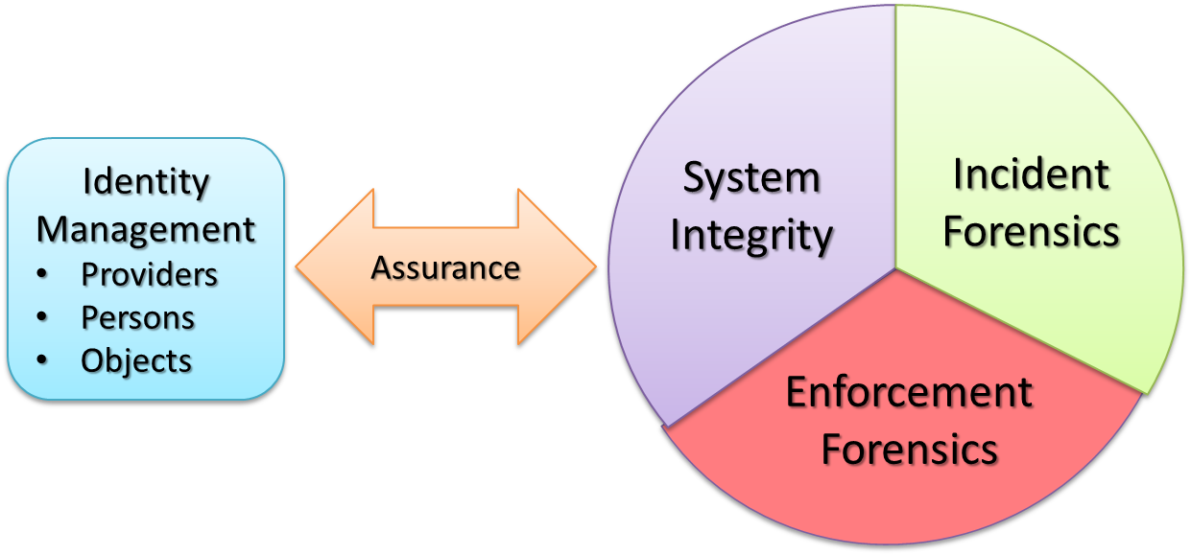
Challenge: Discovery and trust capabilities
Cybersecurity object discovery, trust, and related exchange policy mechanisms are compartmentalized, incoherent, and frequently primitive
Identity Management for cybersecurity has complex assurance relationships

Slide 21
Ongoing relevant cybersecurity IdM developments
eDiscovery
Trusted discovery of identifier meta information is essential in distributed systems
Bob Kahn has been leading effort in ITU-T to develop a X.discovery specification
Resolvers
New joint ISO ITU-T specification ITU-T X.673 | ISO/IEC 29168-2 provides for DNS based ability to resolve OIDs to information addresses
Handles system proceeding in ITU-T
Trust interoperability
Joint ITU-T and ISO X.eaa specification currently being discussed
ENISA trust interoperability protocol may be underway in OASIS
Cloud/Smartgrid Identity
Multiple global initiatives underway to develop specifications for cloud and Smartgrid Identity (ITU-T, OASIS, 3GPP, CEN, ISO, NIST, etc)
Platform trust
Trusted Platform Module and Trusted Network Connect now included in CYBEX standard
Should Virtual TPMs be included?
Distribution channel trust
OID based NID standards emerging as a major object ID platform for distribution chain trust
Handles based DOIs a second order choice
What others exist?
No apparent consensus on use of cyber security object identifiers
NICT contributions have been seminal in exploring naming and discovery options
CNIS (Cyber-security Naming and Information Structures Group) is emerging as a significant new forum for treating CYBEX information identifiers

Slide 22
Challenge: Achieving implementation and widespread use
Much public and industry dialogue is primitive, fractious, and politically contentious at best – especially in the West
See, e.g., FCC Cybersecurity Roadmap proceeding in Docket 10-146
Meaningful platforms (e.g., CYBEX), like the systems involved, are complex
Best initial implementation avenues are within coherent bounded communities
ISOG-J
National government networks
Common Criteria Control Board
NATO
SCAP implementations should proliferate
How to enumerate and discover?
Analytical “bridging” platforms are emerging
Deep Packet Inspection
Application/platform behavior signature enumerations
Ultimately carefully designed mandates by national regulatory authorities seem likely to emerge

Slide 23
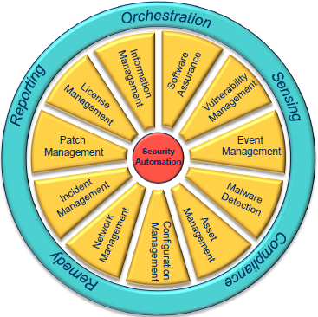
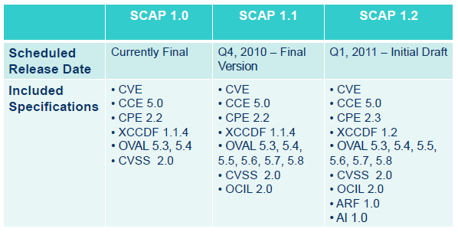
Exemplar: 6th IT Security Automation Conference, Baltimore, 27-29 Sep 2010*
Emerging NIST view of CYBEX as SCAP
A familiar ensemble
A significant dependency
Credit: Overview by Paul Cichonski, BAH-NIST
*See: http://scap.nist.gov/events/2010/itsac/presentations/index.html

Slide 24
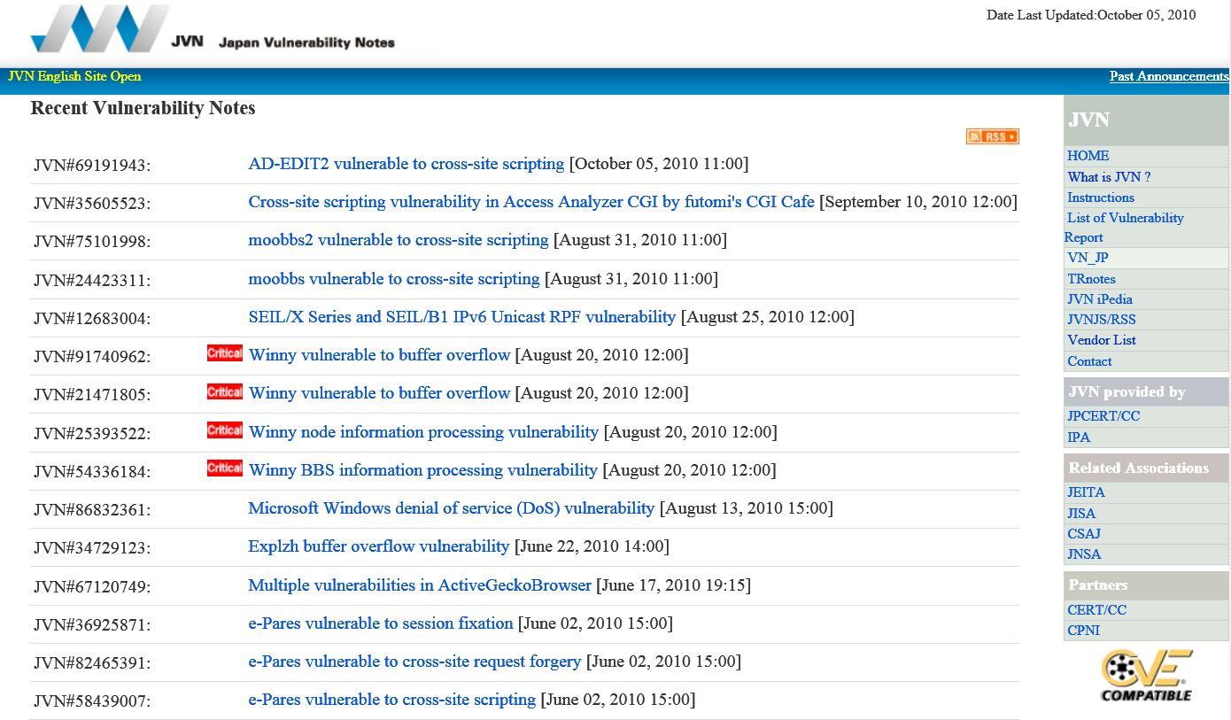
Exemplar: Japan Vulnerability Notes

