Slide 1
TE Topology and Tunnel Modeling for Transport Networks ddraft-ietf-teas-te-topo-and-tunnel-modeling-02
Igor Bryskin (Huawei Technologies)
Xufeng Liu (Jabil)
Vishnu Pavan Beeram (Juniper Networks)
Tarek Saad (Cisco)

Slide 2
Includes:
TE topology modeling constructs and attributes
TE Tunnel modeling constructs and attributes
Use cases explaining use of TE topology and tunnel models

Slide 3
Changes from IETF101 presentation
Draft was adopted as TEAS WG document
Added definitions of multi-domain TE tunneling and TE tunnel/path/connection segments
Addressed TE topology YANG model RFC pre-publication comments
Reflected on– and off-line discussions
Editorial changes

Slide 4
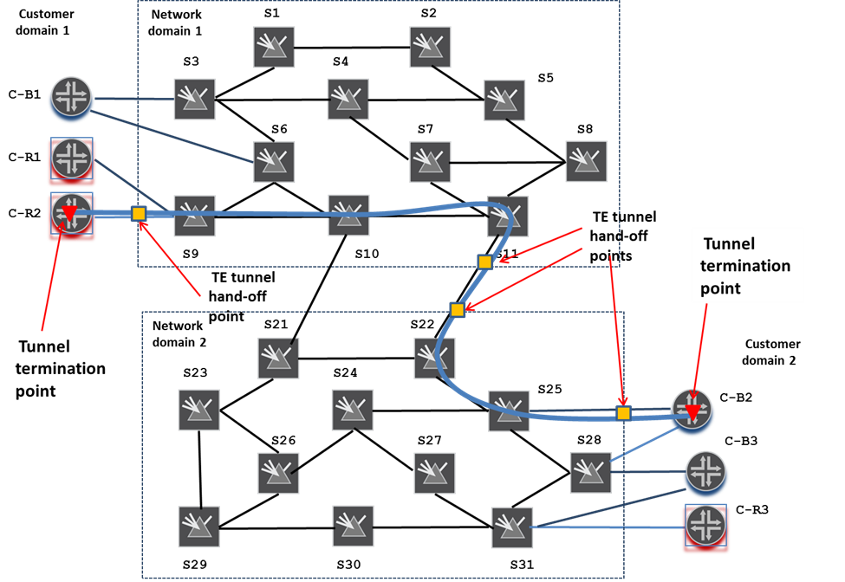
Multi-domain TE tunneling
4

Slide 5
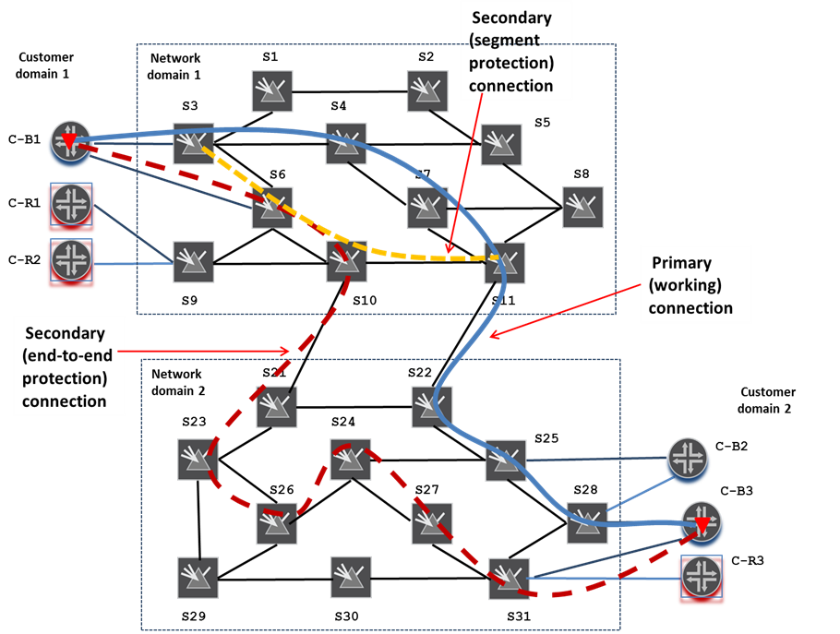
TE Tunnel Components
5

Slide 6
Next steps
Aligning with the latest TE topology and tunnel models
Providing missing definitions and guidance's
Cooperating with Transport NBI work
Soliciting more contributors and contributions
Soliciting more feedback from WG

